Slide 1
ECE/CS 757: Advanced Computer Architecture II
Instructor:Mikko H Lipasti
Spring 2017
University of Wisconsin-Madison
Lecture notes based on slides created by John Shen, Mark Hill, David Wood, Guri Sohi, Jim Smith, Natalie Enright Jerger, Michel Dubois, Murali Annavaram, Per Stenström and probably others

Slide 2
Lecture 3 Outline
Multithreaded processors
Multicore processors

Slide 3
Multithreaded Cores
Basic idea:
  CPU resources are expensive and should not be idle
1960’s: Virtual memory and multiprogramming
  Virtual memory/multiprogramming invented to tolerate latency to secondary storage (disk/tape/etc.)
  Processor-disk speed mismatch:
    microseconds to tens of milliseconds (1:10000 or more)
  OS context switch used to bring in other useful work while waiting for page fault or explicit read/write
  Cost of context switch must be much less than I/O latency (easy)

Slide 4
Multithreaded Cores
1990’s: Memory wall and multithreading
  Processor-DRAM speed mismatch:
    nanosecond to fractions of a microsecond (1:500)
  H/W task switch used to bring in other useful work while waiting for cache miss
  Cost of context switch must be much less than cache miss latency
Very attractive for applications with abundant thread-level parallelism
  Commercial multi-user workloads

Slide 5
Approaches to Multithreading
Fine-grain multithreading
  Switch contexts at fixed fine-grain interval (e.g. every cycle)
  Need enough thread contexts to cover stalls
  Example: Tera MTA, 128 contexts, no data caches
Benefits:
  Conceptually simple, high throughput, deterministic behavior
Drawback:
  Very poor single-thread performance

Slide 6
Approaches to Multithreading
Coarse-grain multithreading
  Switch contexts on long-latency events (e.g. cache misses)
  Need a handful of contexts (2-4) for most benefit
Example: IBM RS64-IV (Northstar), 2 contexts
Benefits:
  Simple, improved throughput (~30%), low cost
  Thread priorities mostly avoid single-thread slowdown
Drawback:
  Nondeterministic, conflicts in shared caches

Slide 7
Approaches to Multithreading
Simultaneous multithreading
  Multiple concurrent active threads (no notion of thread switching)
  Need a handful of contexts for most benefit (2-8)
Examples: Intel P4, Intel Nehalem, IBM Power 5/6/7/8, Alpha EV8/21464, AMD Zen
Benefits:
  Natural fit for OOO superscalar
  Improved throughput
  Low incremental cost
Drawbacks:
  Additional complexity over OOO superscalar
  Cache conflicts

Slide 8
Approaches to Multithreading
Chip Multithreading (CMT)
  Similar to CMP
Share something in the core:
  Expensive resource, e.g. floating-point unit (FPU)
  Also share L2, system interconnect (memory and I/O bus)
Example: Sun Niagara, 8 cores per die, one FPU
Benefits:
  Same as CMP
  Further: amortize cost of expensive resource over multiple cores
Drawbacks:
  Shared resource may become bottleneck
  2nd generation (Niagara 2) does not share FPU

Slide 9
Multithreaded/Multicore Processors
MT Approach | Resources shared between threads | Context Switch Mechanism
None | Everything | Explicit operating system context switch
Fine-grained | Everything but register file and control logic/state | Switch every cycle
Coarse-grained | Everything but I-fetch buffers, register file and con trol logic/state | Switch on pipeline stall
SMT | Everything but instruction fetch buffers, return address stack, architected register file, control logic/state, reorder buffer, store queue, etc. | All contexts concurrently active; no switching
CMT | Various core components (e.g. FPU), secondary cache, system interconnect | All contexts concurrently active; no switching
CMP | Secondary cache, system interconnect | All contexts concurrently active; no switching
Many approaches for executing multiple threads on a single die
  Mix-and-match: IBM Power8 CMP+SMT

Slide 10
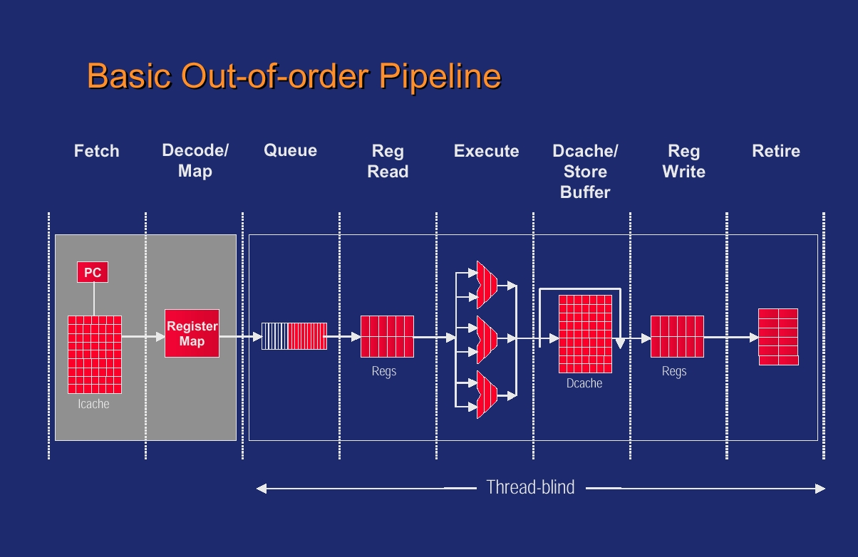
SMT Microarchitecture [Emer,’01]

Slide 11
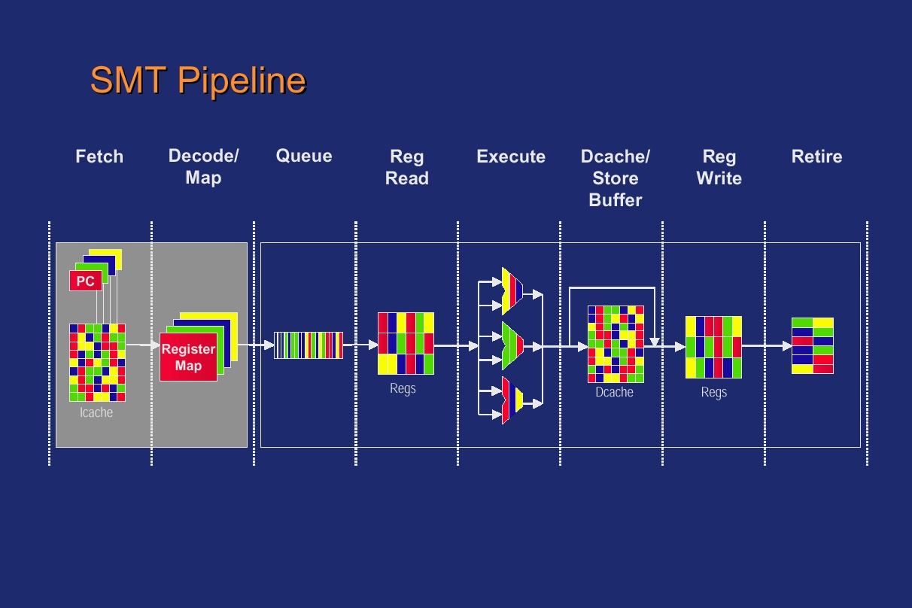
SMT Microarchitecture [Emer,’01]

Slide 12
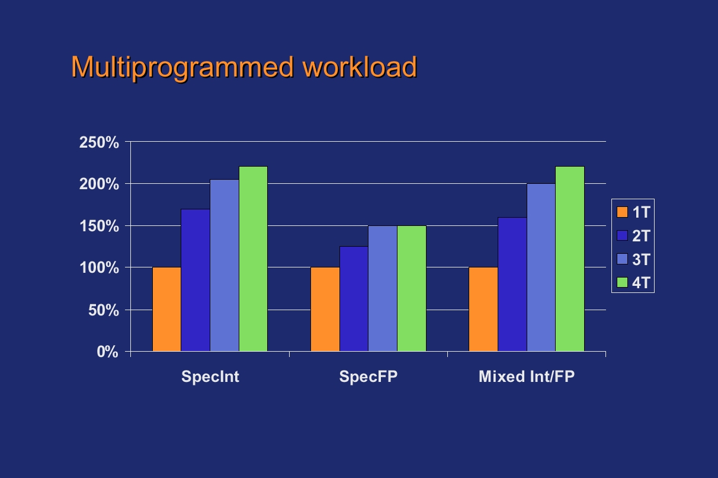
SMT Performance [Emer,’01]

Slide 13
Historical Multithreaded Processors
CDC6600 PPs
  I/O processing
Denelcor HEP
  General purpose scientific

Slide 14
CDC 6600 Peripheral Processors
Intended to perform OS and I/O functions
Used "barrel and slot"
  register state is arranged around a “barrel”
  one set of ALU and memory hardware accessed through “slot” in barrel
  slot in barrel rotates one position each cycle
Could be used as stand-alone "MP"
Similar method later used in IBM Channels

Slide 15
CDC 6600 Peripheral Processors

Slide 16
Denelcor HEP
General purpose scientific computer
Organized as an MP
  Up to 16 processors
  Each processor is multithreaded
  Up to 128 memory modules
  Up to 4 I/O cache modules
  Three-input switches and chaotic routing

Slide 17
HEP Processor Organization
Multiple contexts (threads) are supported;
  120 threads
  Each with a PSW (program status word)
PSWs circulate in a control loop
  control and data loops pipelined 8 deep
  PSW in control loop can circulate no faster than data in data loop
  PSW at queue head fetches and starts execution of next instruction
  No inter-instruction pipeline forwarding or stalls needed
Clock period: 100 ns
  8 PSWs in control loop => 10 MIPS
  Maximum perf. per thread => 1.25 MIPS
  (They tried to sell this as a supercomputer)

Slide 18
HEP Processor Organization
opcode
Scheduler
Main
Function
Memory
Unit
PSW Queue
PSW
Instruction
reg.
Register
operands
Memory
addresses
Memory
non-
memory
results
Function
insts.
memory
Units
Increment
Delay
insts.
PSW Buffer
pending memory

Slide 19
HEP Processor, contd.
Address space: 32K to 1Mwords (64 bits)
64 bit instructions
2048 GP registers + 4096 constants
  Registers can be shared among threads
Memory operation
  Loads and stores performed by scheduler functional unit (SFU)
  SFU builds network packet and sends it into switch
  PSW is removed from control loop and placed in SFU queue
  PSW is placed back into control loop following memory response
Special operations
  control instructions to create/terminate threads
  full/empty bits in memory and registers
    busy wait on empty/full operands

Slide 20
Switch
Packet switched, but bufferless
3 bi-directional ports per switch
  Every cycle, take in 3 packets, send out 3 packets
"Hot Potato" routing
  Form of adaptive routing
  Do not enqueue on a port conflict
    Send anyway on another port and raise priority
  At top priority (15) traverse a circuit through the net
  Revisited: C. Fallin, “CHIPPER: …” HPCA 2011

Slide 21
Modern Day Multi-Threading
Apply to superscalar pipelines
  More resources to share
Also one-wide in-order processors
  Provide high efficiency for throughput-oriented servers
Start with case study
  Intel Pentium 4 Hyperthreading
  D. Marr et al. Hyper-Threading Technology Architecture and Microarchitecture. Intel Technology Journal, Feb. 2002

Slide 22
Intel Hyperthreading
Part of Pentium 4 design (Xeon)
Two threads per processor
Goals
  Low cost – less than 5% overhead for replicated state
  Assure forward progress of both threads
    Make sure both threads get some buffer resources
    through partitioning or budgeting
  Single thread running alone does not suffer slowdown

Slide 23
Intel Hyperthreading
Main pipeline
  Pipeline prior to trace cache not shown
Round-Robin instruction fetching
  Alternates between threads
  Avoids dual-ported trace cache
  BUT trace cache is a shared resource

Slide 24
Trace Caches
Trace cache captures dynamic traces
Increases fetch bandwidth
Help shorten pipeline (if predecoded)
Instruction Cache
Trace Cache

Slide 25
Capacity Resource Sharing
Append thread identifier (TId) to threads in shared capacity (storage) resource
Example: cache memory

Slide 26
Frontend Implementation
Partitioned front-end resources
  Fetch queue (holds uops)
  Rename and allocate tables
  Post-rename queues
Partitioning assures forward progress if other thread is blocked
  Round-robin scheduling

Slide 27
Backend Implementation
Physical registers are pooled (shared)
Five instruction buffers (schedulers)
  Shared
  With an upper limit
Instruction issue is irrespective of thread ID
Instruction commit is round-robin
  From partitioned ROB

Slide 28
Operating Modes and OS Support
MT-mode – two active logical processors; shared/partitioned resources
ST-mode (ST0 or ST1) – one logical processor; combined resources
HALT – privileged instruction => (normally) low power mode
  IN MT mode => transition to ST0 or ST1
  (depending on the thread that HALTed)
  In ST mode => low power mode
Interrupt to HALTed thread => transition to MT mode
OS manages two “processors”
  OS code should HALT rather than idle loop
  Schedule threads with priority to ST mode
    (require OS knowledge of hyperthreading)

Slide 29
Performance
OLTP workload
  21% gain in single and dual systems
  Likely external bottleneck in 4 processor systems
    Most likely front-side bus (FSB), i.e. memory bandwidth

Slide 30
Performance
Web server apps

Slide 31
Intel Hyperthreading Summary
Mix of partitioned and shared resources
Mostly round-robin scheduling
Primary objective: performance
Secondary objective: fairness

Slide 32
Policies and Mechanisms
Separate primitives (mechanisms) from solutions (policies)
  Generally good computer engineering
  Allows flexibility in policies (during and after design)
Example
  Mechanism: Program counter multiplexer in IFetch stage
  Policy: mux control – round-robin (or priorities)

Slide 33
Example: Hyperthreading
Mechanisms (and Policies) in Pentium 4

Slide 34
Dispatch Policy
Primary point for resource management
Intel design uses software-settable priorities
  Set via software writeable control register
  Application software can control some of the priority settings
  Priority 0 => idle, priority 1 => spinning
  Both threads at level 1 => throttle to save power
Hardware feedback can adjust priorities
Reference:
  D.M. Tullsen et al., ”Exploiting choice:…” ISCA 1996.

Slide 35
SMT Register File Capacity
IBM Power8: 12 cores, 8T each, (32 FX+32FP) registers per thread. Consider FX only:
  8x32 = 256 physical registers minimum
  Also need registers for inflight instructions
    GCT (ROB) is 28x8=224 instructions x 75% = 168 registers
  Total demand: 168+256 = 424 !!!
  Very large, slow, power hungry
  Instead: two-level RF for SMT8 mode:
    1st level is a cache of 124+124)
More: B. Sinharoy et al., “IBM POWER8 processor core microarchitecture, ” IBM J R&D 59(1), Jan 2015.

Slide 36
Multithreading Summary
Goal: increase throughput
  Not latency
Utilize execution resources by sharing among multiple threads:
  Fine-grained, coarse-grained, simultaneous
Usually some hybrid of fine-grained and SMT
  Front-end is FG, core is SMT, back-end is FG
Resource sharing
  I$, D$, ALU, decode, rename, commit – shared
  IQ, ROB, LQ, SQ – partitioned vs. shared
Historic multithreaded machines
Recent examples

Slide 37
Lecture 3 Outline
Multithreaded processors
Multicore processors

Slide 38
Processor Performance
Time
Processor Performance = ---------------
Program
=
Instructions
Cycles
Time
X
X
Program
Instruction
Cycle
(code size)
(CPI)
(cycle time)
In the 1980’s (decade of pipelining):
  CPI: 5.0 => 1.15
In the 1990’s (decade of superscalar):
  CPI: 1.15 => 0.5 (best case)
In the 2000’s (decade of multicore):
  Core CPI unchanged; chip CPI scales with #cores

Slide 39
Multicore Objectives
Use available transistors to add value
  Provide better perf, perf/cost, perf/watt
Effectively share expensive resources
  Socket/pins:
    DRAM interface
    Coherence interface
    I/O interface
  On-chip area/power
    Mem controller
    Cache
    FPU? (Conjoined cores, e.g. Niagara)

Slide 40
High-Level Design Issues
Where to connect cores?
  Time to market:
    at off-chip bus (Pentium D)
    at coherence interconnect (Opteron Hypertransport)
  Requires substantial (re)design:
    at L2 (Power 4, Core Duo, Core 2 Duo, etc.)
    at L3 (Opteron, Itanium, etc.)

Slide 41
High-Level Design Issues
Share caches?
  yes: all designs that connect at L2 or L3
  no: initial designs that connected at “bus”
Coherence?
  Private caches? Reuse existing MP/socket coherence
    Opportunity missed to optimize for on-chip sharing?
  Shared caches?
    Need new coherence protocol for on-chip caches
    Could be write-through L1 with back-invalidates for other caches

Slide 42
High-Level Design Issues
How to connect?
  Off-chip bus? Time-to-market hack, not scalable
  Existing pt-to-pt coherence interconnect
    e.g. AMD’s hypertransport
  Shared L2/L3:
    Crossbar, up to 3-4 cores
    1D “UMA/dancehall“ organization with crossbar
  On-chip bus? Not very scalable
  Interconnection network
    scalable, but high overhead, design complexity
    E.g. ring, 2D tiled organization, mesh interconnect

Slide 43
Shared vs. Private L2/L3
Bandwidth issues
  Data: if shared then banked/interleaved
  Tags: snoop b/w into L2 (L1 if not inclusive)
Cache misses: per core vs. per chip
  Compare same on-chip capacity (e.g. 4MB)
  When cores share data:
    Cold/capacity/conflict misses fewer in shared cache
    Communication misses greater in private cache
  Conflict misses can increase with shared cache
    Fairness issues between cores

Slide 44
Shared vs. Private L2/L3
Access latency: fixed vs. NUCA (interconnect)
  Classic UMA (dancehall) vs. NUMA/NUCA
  Collocate LLC banks with cores
    Commonly assumed in research literature
Complexity due to bandwidth:
  Arbitration
  Concurrency/interaction
Coherent vs. non-coherent shared LLC
  LLC can be "memory cache” below “coherence”
  Only trust contents after snoop/coherence has determined that no higher-level cache has a dirty copy

Slide 45
Multicore Coherence
All private caches:
  reuse existing protocol, if scalable enough
Some shared cache
  New LL shared cache is non-coherent (easy)
    Use existing protocol to find blocks in private L2/L1
    Serialize L3 access; use as memory cache
  New shared LLC is coherent (harder)
    Complexity of multilevel protocols is underappreciated
    Could flatten (treat as peers) but:
      Lose opportunity
      May not be possible (due to inclusion, WB/WT handling)
    Combinatorial explosion due to multiple protocols interacting

Slide 46
Multicore Coherence
Shared L2 is coherent via writethru L1
  Still need sharing list to forward invalidates/writes
  Ordering of WT stores and conflicting loads, coherence messages not trivial
  WT bandwidth is expensive
Shared L2 with writeback L1
  Combinatorial explosion of multiple protocols
  Fractal coherence (MICRO ‘10), manager-client pairing (MICRO’11) addresses this issue

Slide 47
Multicore Interconnects
Bus/crossbar - dismiss as short-term solutions?
Point-to-point links, many possible topographies
  2D (suitable for planar realization)
    Ring
    Mesh
    2D torus
  3D - may become more interesting with 3D packaging (chip stacks)
    Hypercube
    3D Mesh
    3D torus
More detail in subsequent NoC unit

Slide 48
Cross-bar (IBM Power4-Power8)
Core0
Core1
Core2
Core3
Core4
Core5
Core6
Core7
L1 $
L1 $
L1 $
L1 $
L1 $
L1 $
L1 $
L1 $
8X9 Cross-Bar Interconnect
L2 $ Bank0
L2 $ Bank1
L2 $ Bank2
L2 $ Bank3
L2 $ Bank4
L2 $ Bank5
L2 $ Bank6
L2 $ Bank7
I/O
Memory Controller
Memory Controller
Memory Controller
Memory Controller

Slide 49
On-Chip Bus/Crossbar
Used widely (Power4/5/6/7/8, Piranha, Niagara, etc.)
  Assumed not scalable
  Is this really true, given on-chip characteristics?
  Scales "far enough" : watch out for arguments at the limit
  e.g. swizzle-switch makes x-bar scalable enough [UMich]
Simple, straightforward, nice ordering properties
  Wiring can be a nightmare (for crossbar)
  Bus bandwidth is weak (even multiple busses)
  Compare DEC Piranha 8-lane bus (32GB/s) to Power4 crossbar (100+GB/s)
  Workload BW demands: commercial vs. scientific

Slide 50
On-Chip Ring (e.g. Intel)
Core0
L2 $ Bank0
L2 $ Bank3
Core3
L1 $
L1 $
Core1
Core2
L2 $ Bank1
L2 $ Bank2
L1 $
L1 $
Memory Controller
Router
Directory Coherence
QPI/HT Interconnect

Slide 51
On-Chip Ring
Point-to-point ring interconnect
  Simple, easy
  Nice ordering properties (unidirectional)
  Every request a broadcast (all nodes can snoop)
  Scales poorly: O(n) latency, fixed bandwidth
Optical ring (nanophotonic)
  HP Labs Corona project [ISCA 08]
  Much lower latency (speed of light)
  Still fixed bandwidth (but lots of it)

Slide 52
On-Chip Mesh
Widely assumed in academic literature
Tilera (Wentzlaff reading [19])
Not symmetric, so have to watch out for load imbalance on inner nodes/links
  2D torus: wraparound links to create symmetry
    Not obviously planar
    Can be laid out in 2D but longer wires, more intersecting links
Latency, bandwidth scale well
Lots of recent research in the literature

Slide 53
CMP Examples
Chip Multiprocessors (CMP)
Becoming very popular
Processor | Cores/ chip | Multi-threaded? | Resources shared
IBM Power 4 | 2 | No | L2/L3, system interface
IBM Power7 | 8 | Yes (4T) | Core, L2/L3, system interface
Sun Ultrasparc | 2 | No | System interface
Sun Niagara | 8 | Yes (4T) | Everything
Intel Pentium D | 2 | Yes (2T) | Core, nothing else
AMD Opteron | 2 | No | System interface (socket)

Slide 54
IBM Power4: Example CMP

Slide 55
Niagara Case Study
Targeted application: web servers
  Memory intensive (many cache misses)
  ILP limited by memory behavior
  TLP: Lots of available threads (one per client)
Design goal: maximize throughput (/watt)
Results:
  Pack many cores on die (8)
  Keep cores simple to fit 8 on a die, share FPU
  Use multithreading to cover pipeline stalls
  Modest frequency target (1.2 GHz)

Slide 56
Niagara Block Diagram [Source: J. Laudon]
8 in-order cores, 4 threads each
4 L2 banks, 4 DDR2 memory controllers

Slide 57
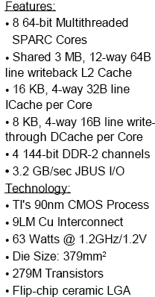
Ultrasparc T1 Die Photo [Source: J. Laudon]

Slide 58
Niagara Pipeline [Source: J. Laudon]
Shallow 6-stage pipeline
Fine-grained multithreading

Slide 59
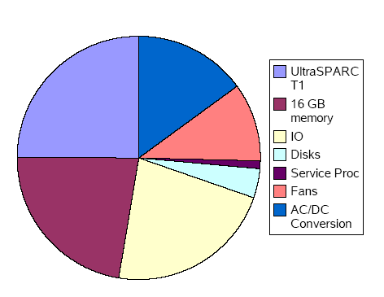
T2000 System Power
271W running SpecJBB2000
Processor is only 25% of total
DRAM & I/O next, then conversion losses

Slide 60
Niagara Summary
Example of application-specific system optimization
  Exploit application behavior
    TLP, cache misses, low ILP
  Build very efficient solution
Downsides
  Loss of general-purpose suitability
  E.g. poorly suited for software development (parallel make, gcc)
  Very poor FP performance (fixed in Niagara 2)

Slide 61
CMPs WITH HETEROGENEOUS CORES
Workloads have different characteristics
  Large number of small cores (applications with high thread count)
  Small number of large cores (applications with single thread or limited thread count)
  Mix of workloads
  Most parallel applications have both serial and parallel sections (Amdahl’s Law)
Hence, heterogeneity
  Temporal: EPI throttling via DVFS
  Spatial: Each core can differ either in performance or functionality
Performance asymmetry
  Using homogeneous cores and DVFS, or processor with mixed cores (ARM BIG.little)
  Variable resources: e.g., adapt size of cache via power gating of cache banks
  Speculation control (unpredictable branches): throttle in-flight instructions (reduces activity factor)
Method | EPI Range | Time to vary EPI
DVFS | 1:2 to 1:4 | 100 us, ramp V_{cc}
Variable Resources | 1:1 to 1:2 | 1 us, Fill L1
Speculation Control | 1:1 to 1:1.4 | 10 ns, Pipe flush
Mixed Cores | 1:6 to 1:11 | 10 us, Migrate L2

Slide 62
CMPs WITH HETEROGENEOUS CORES (Functional Asymmetry)
Use heterogeneous cores
  E.g., GP cores, GPUs, cryptography, vector cores, floating point coprocessors
  Heterogeneous cores may be programmed differently
  Mechanisms must exist to transfer activity from one core to another
    Fine-grained: e.g. FP co-processor, use ISA
    Coarse-grained: transfer computation using APIs
Examples:
  Cores with different ISAs
  Cores with different cache sizes, different issue width, different branch predictors
  Cores with different micro-architectures (in-order vs. out-of-order)
  Different types of cores (GP and SIMD)
Goals:
  Save area (more cores)
  Save power by using cores with different power/performance characteristics for different phases of execution

Slide 63
CMPs WITH HETEROGENEOUS CORES
Different applications may have better performance/power characteristics on some types of core (static)
Same application goes through different phases that can use different cores more efficiently (dynamic)
  Execution moves from core to core dynamically
  Most interesting case (dynamic)
  Cost of switching cores (must be infrequent: such as O/S time slice)
Assume cores with same ISA but different performance/energy ratio
  Need ability to track performance and energy to make decisions
  Goal: minimize energy-delay product (EDP)
  Periodically sample performance and energy spent
    Run application on one or multiple cores in small intervals
  Possible heuristics
    Neighbor: pick one of the two neighbors at random, sample, switch if better
    Random: select a core at random and sample, switch if better
    All: sample all cores and select the best
    Consider the overhead of sampling

Slide 64
Multicore Summary
Objective: resource sharing, power efficiency
  Where to connect
  Cache sharing
  Coherence
  How to connect
Examples/case studies
Heterogeneous CMPs
Readings
  [6] K. Olukotun, et al., "The Case for a Single-Chip Multiprocessor," ASPLOS-7, October 1996.
  [7] Kumar, R., et al., "Heterogeneous Chip Multiprocessors", IEEE Computer, pp. 32-38, Nov. 2005

Slide 65
Lecture 3 Summary
Multithreaded processors
Multicore processors

