Slide 1
Interconnection Networks: Introduction
Natalie Enright Jerger
Notes:
(some adapted from Interconnection Networks
Computer Architecture: A Quantitative Approach
4th Edition, Appendix E, Timothy Pinkston and Jose Duato)

Slide 2
Introduction
How to connect individual devices into a group of communicating devices?
  A device can be:
    Component within a chip
    Component within a computer
    Computer
    System of computers
  Network consists of:
    End point devices with interface to network
    Links
    Interconnect hardware
Goal: transfer maximum amount of information with the least cost (minimum time, power)

Slide 3
Types of Interconnection Networks
Interconnection networks can be grouped into four domains
  Depending on number and proximity of devices to be connected
On-Chip networks (OCNs or NoCs)
  Devices include microarchitectural elements (functional units, register files), caches, directories, processors
  Current designs: small number of devices
    Ex: IBM Cell, Sun’s Niagara
  Projected systems: dozens, hundreds of devices
    Ex: Intel Teraflops research prototypes, 80 cores
  Proximity: millimeters

Slide 4
Types of Interconnection Networks (2)
System/Storage Area Network (SANs)
  Multiprocessor and multicomputer systems
    Interprocessor and processor-memory interconnections
  Server and data center environments
    Storage and I/O components
  Hundreds to thousands of devices interconnected
    IBM Blue Gene/L supercomputer (64K nodes, each with 2 processors)
  Maximum interconnect distance typically on the order of tens of meters, but some with as high as a few hundred meters
    InfiniBand: 120 Gbps over a distance of 300 m
  Examples (standards and proprietary)
    InfiniBand, Myrinet, Quadrics, Advanced Switching Interconnect

Slide 5
Types of Interconnection Networks (3)
Local Area Network (LANs)
  Interconnect autonomous computer systems
  Machine room or throughout a building or campus
  Hundreds of devices interconnected (1,000s with bridging)
  Maximum interconnect distance on the order of few kilometers, but some with distance spans of a few tens of kilometers
  Example (most popular): Ethernet, with 10 Gbps over 40Km

Slide 6
Types of Interconnection Networks (4)
Wide Area Networks (WANs)
  Interconnect systems distributed across the globe
  Internetworking support is required
  Many millions of devices interconnected
  Maximum interconnect distance of many thousands of kilometers
  Example: ATM

Slide 7
Organization
Next few lectures will focus on On-chip networks
Concepts applicable to all types of networks
  Focus on trade-offs and constraints as applicable to NoCs

Slide 8
On-Chip Networks (NoCs)
Why Network on Chip?
  Ad-hoc wiring does not scale beyond a small number of cores
    Prohibitive area
    Long latency
OCN offers
  scalability
  efficient multiplexing of communication
  often modular in nature (ease verification)

Slide 9
Differences between on-chip and off-chip networks
  Off-chip: I/O bottlenecks
    Pin-limited bandwidth
    Inherent overheads of off-chip I/O transmission
  On-chip
    Tight area and power budgets
    Ultra-low on-chip latencies

Slide 10
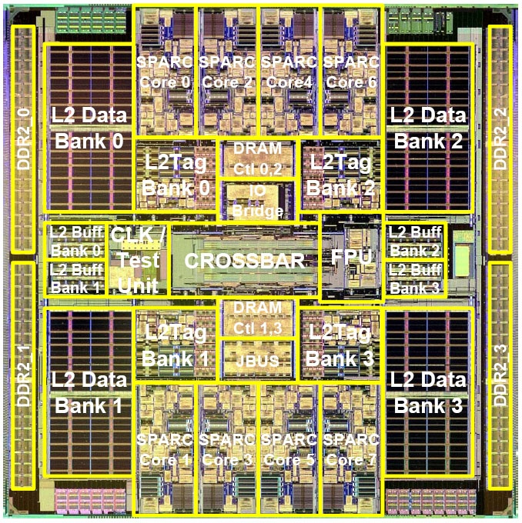
MulticoreExamples (1)
0
1
2
3
4
5
0
1
XBAR
2
3
4
5
Sun Niagara

Slide 11
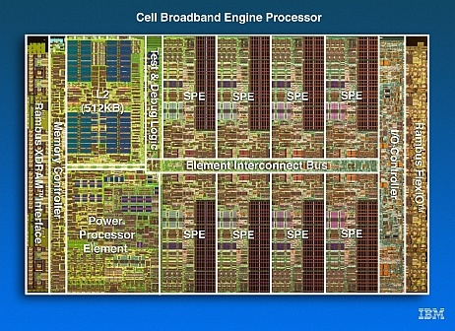
MulticoreExamples (2)
Element Interconnect Bus
  4 rings
  Packet size: 16B-128B
  Credit-based flow control
  Up to 64 outstanding requests
  Latency: 1 cycle/hop
RING
IBM Cell
Notes:
\

Slide 12
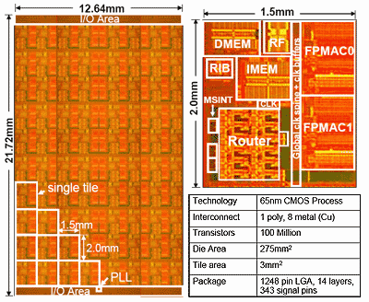
Many Core Example
Intel Polaris
  80 core prototype
Academic Research ex:
  MIT Raw, TRIPs
    2-D Mesh Topology
    Scalar Operand Networks
2D MESH
Notes:
The last current example I have is the Intel Polaris prototype. This is an 80-core prototype that connects cores via a 2-D grid or mesh network. I’ve highlighted the mesh in white on the die photo. At each intersection in the mesh, there is a router. The router makes decisions about how messages travel through the network. If you look at the blown up photo of one of the 80 tiles, you can see that the router occupies roughly 25% of the area of a tile. Significant area and power will be devoted to the on-chip network in future designs so it is crucial that we utilize this area efficiently for high performing solutions.
Add RAW, TRIPs

Slide 13
Suggested Reading
William Dally and Brian Towles. Principles and Practices of Interconnection Net- works. Morgan Kaufmann Pub., San Francisco, CA, 2003.
William Dally and Brian Towles, “Route packets not wires: On-chip interconnection networks,” in Proceedings of the 38th Annual Design Automation Conference (DAC-38), 2001, pp. 684–689.
David Wentzlaﬀ, Patrick Griﬃn, Henry Hoﬀman, LieweiBao, Bruce Edwards, Carl Ramey, Matthew Mattina, Chi-Chang Miao, John Brown I I I, and AnantAgarwal. On-chip interconnection architecture of the tile processor. IEEE Micro, pages 15– 31, 2007.
Michael Bedford Taylor, Walter Lee, SamanAmarasinghe, and AnantAgarwal. Scalar operand networks: On-chip interconnect for ILP in partitioned architectures. In Proceedings of the International Symposium on High Performance Computer Architecture, February 2003.
S. Vangal, J. Howard, G. Ruhl, S. Dighe, H. Wilson, J. Tschanz, D. Finan, P. Iyer, A. Singh, T. Jacob, S. Jain, S. Venkataraman, Y. Hoskote, and N. Borkar. An 80-tile 1.28tﬂops network-on-chip in 65nm cmos. Solid-State Circuits Conference, 2007. ISSCC 2007. Digest of Technical Papers. IEEE International, pages 98–589, Feb. 2007.

