Slide 1
Day 1: Introduction
Course: Superscalar Architecture
12th International ACACES Summer School
10-16 July 2016, Fiuggi, Italy
© Prof. Mikko Lipasti
Lecture notes based in part on slides created by John Shen and Ilhyun Kim

Slide 2
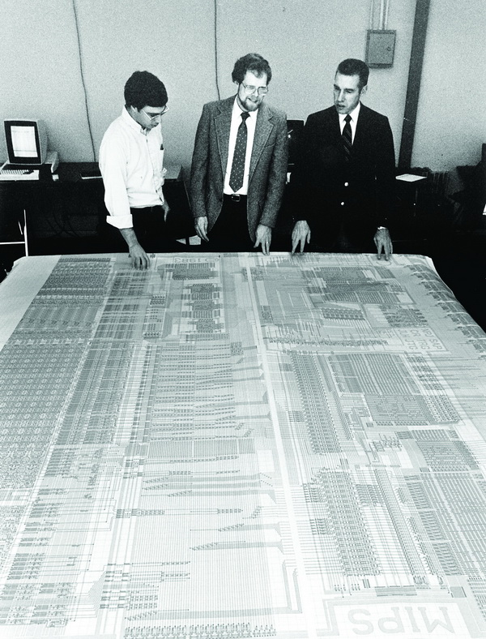
CPU, circa 1986
Stage | Phase | Function performed
IF | φ₁ | Translate virtual instr. addr. using TLB
 | φ₂ | Access I-cache
RD | φ₁ | Return instruction from I-cache, check tags & parity
 | φ₂ | Read RF; if branch, generate target
ALU | φ₁ | Start ALU op; if branch, check condition
 | φ₂ | Finish ALU op; if ld/st, translate addr
MEM | φ₁ | Access D-cache
 | φ₂ | Return data from D-cache, check tags & parity
WB | φ₁ | Write RF
 | φ₂
Source: https://imgtec.com
MIPS R2000, ~“most elegant pipeline ever devised” J. Larus
Enablers: RISC ISA, pipelining, on-chip cache memory

Slide 3
Iron Law
Time
Processor Performance = ---------------
Program
=
Instructions
Cycles
Time
X
X
Program
Instruction
Cycle
(code size)
(CPI)
(cycle time)
Architecture --> Implementation --> Realization
Compiler Designer Processor Designer Chip Designer

Slide 4
Limitations of Scalar Pipelines
Scalar upper bound on throughput
  IPC <= 1 or CPI >= 1
Rigid pipeline stall policy
  One stalled instruction stalls entire pipeline
Limited hardware parallelism
  Only temporal (across pipeline stages)

Slide 5
Superscalar Proposal
Fetch/execute multiple instructions per cycle
Decouple stages so stalls don’t propagate
Exploit instruction-level parallelism (ILP)
Notes:
Not 100 or 1000 degree of parallelism, but 2-3-4
Fine-grained vs. medium-grained (loop iterations) vs. coarse-grained (threads)

Slide 6
Limits on Instruction Level Parallelism (ILP)
Weiss and Smith [1984] | 1.58
Sohi and Vajapeyam [1987] | 1.81
Tjaden and Flynn [1970] | 1.86 (Flynn’s bottleneck)
Tjaden and Flynn [1973] | 1.96
Uht [1986] | 2.00
Smith et al. [1989] | 2.00
Jouppi and Wall [1988] | 2.40
Johnson [1991] | 2.50
Acosta et al. [1986] | 2.79
Wedig [1982] | 3.00
Butler et al. [1991] | 5.8
Melvin and Patt [1991] | 6
Wall [1991] | 7 (Jouppi disagreed)
Kuck et al. [1972] | 8
Riseman and Foster [1972] | 51 (no control dependences)
Nicolau and Fisher [1984] | 90 (Fisher’s optimism)
Notes:
Flynn’s bottleneck: IPC < 2 because of branches, control flow
Fisher’s optimism: benchmarks very loop-intensive scientific workloads, led to Multiflow startup, Trace VLIW machine
Variance due : benchmarks, machine models, cache latency & hit rate, compilers, religious bias, gen. Purpose vs. special purpose/scientific, C vs. Fortran
Not monotonic with time
Jouppi disagreed with 7

Slide 7
High-IPC Processor Evolution
Desktop/Workstation Market
Scalar RISC Pipeline
2-4 Issue
In-order
Limited Out-of-Order
Large ROB Out-of-Order
1980s:
MIPS
SPARC
Intel 486
Early 1990s:
IBM RIOS-I
Intel Pentium
Mid 1990s:
PowerPC 604
Intel P6
2000s:
DEC Alpha 21264
IBM Power4/5
AMD K8
1985 – 2005: 20 years, 100x frequency
Mobile Market
Scalar RISC Pipeline
2-4 Issue
In-order
Limited Out-of-Order
Large ROB Out-of-Order
2002: ARM11
2005: Cortex A8
2009: Cortex A9
2011: Cortex A15
2002 – 2011: 10 years, 10x frequency

Slide 8
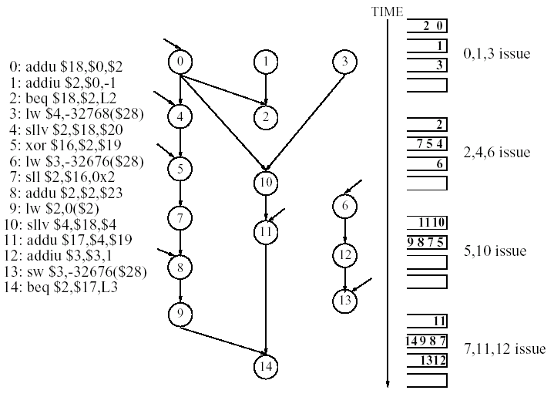
What Does a High-IPC CPU Do?
Fetch and decode
Construct data dependence graph (DDG)
Evaluate DDG
Commit changes to program state
Source: [Palacharla, Jouppi, Smith, 1996]

Slide 9
A Typical High-IPC Processor
1. Fetch and Decode
2. Construct DDG
3. Evaluate DDG
4. Commit results

Slide 10
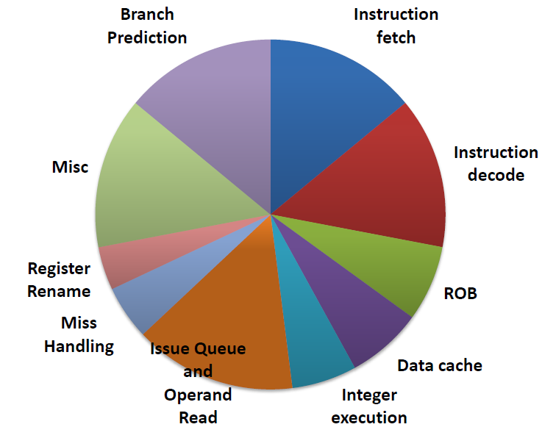
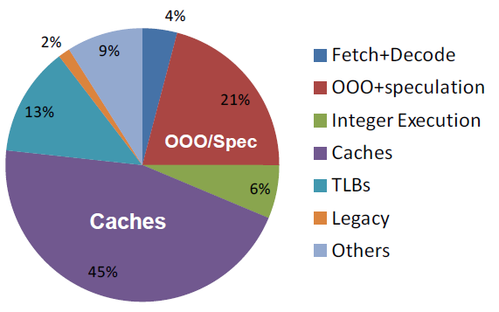
Power Consumption
ARM Cortex A15 [Source: NVIDIA]
Core i7 [Source: Intel]
Actual computation overwhelmed by overhead of aggressive execution pipeline

Slide 11
Lecture Outline
Evolution of High-IPC Processors
Main challenges
  Instruction Flow
  Register Data Flow
  Memory Data Flow

Slide 12
High-IPC Processor

Slide 13
Instruction Flow
Objective: Fetch multiple instructions per cycle
Challenges:
  Branches: unpredictable
  Branch targets misaligned
  Instruction cache misses
Solutions
  Prediction and speculation
  High-bandwidth fetch logic
  Nonblocking cache and prefetching
PC
Instruction Cache
only 3 instructions fetched
Notes:
Don’t starve the pipeline: n/cycle
Must fetch n/cycle from I$

Slide 14

I-Cache Organization
$$\text{Capacity} \text{C}\text{ = }\text{x} × \text{y}$$
$$Latency L=x+y$$
$$→L=x+\frac{C}{x}$$
$$→\frac{dL}{dx}=1 −\frac{C}{x^{2}}=0$$
$$→x= \sqrt[2]{C}$$
Address
Address
Cache
r
TAG
Line
r
Cache
e
e
TAG
d
TAG
d
o
o
Line
c
•
•
c
•
e
•
•
e
•
•
D
•
•
D
•
•
•
w
TAG
w
TAG
o
o
R
TAG
R
1 cache line = 1 physical row
1 cache line = 2 physical rows
SRAM arrays need to be square to minimize delay
Notes:
Physical implementation constraints: want array to be square, not rectangular, e.g.
32K 2-w SA with 64B blocks: naïve array is 100 tag+512 inst per row by 256 rows
Optimized would be 100 tag + 256 inst per row by 512 rows (still not quite square)
Why square? Latency l = x + y, capacity C = x * y.
Substitute l = x + C/x, take derivative dl/dx = 1 – C/x^2, set to 0 and solve for x:
C/x^2 = 1 => x = sqrt(C), also y = sqrt (C), hence x = y, hence square

Slide 15
Fetch Alignment
Notes:
Fetch size n=4: losing fetch bandwidth if not aligned
Static/compiler: align branch targets at 00 (may need to pad with NOPs); implementation specific

Slide 16
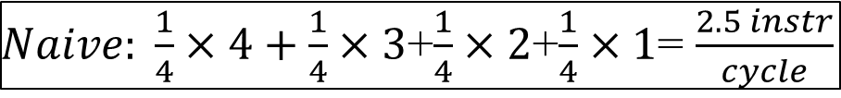
IBM RIOS-I Fetch Hardware
$Naive: \frac{1}{4}×4+\frac{1}{4}×3$+$\frac{1}{4}×2$+$\frac{1}{4}×1$= $\frac{2.5 instr}{cycle}$
$Optimized: \frac{13}{16}×4+\frac{1}{16}×3$+$\frac{1}{16}×2$+$\frac{1}{16}×1$= $\frac{3.625 instr}{cycle}$
Notes:
1989 design used in the first IBM RS/6000 (POWER or RIOS-I): 4-wide machine with Int, FP, BR, CR (typically 2 or fewer issue)
2-way set-assoc, linesize 64B spans 4 physical rows, each instruction word interleaved
Say fetch i is B10, i+1 is B11and chooses appropriate index
Mux selects based on tag match.
I-buffer network rotates instructions so they leave in program order
Efficiency: 13/16 x 4 + 1/16 x 3 + 1/16 x 2 + 1/16 x 1 = 3.625 I/cycle (pretty close to 4). Naïve would be ¼ x 4 + ¼ x 3 + ¼ x 2 + ¼ x 1 = 2.5 I/cycle
“Interleaved sequential” improves by interleaving tag array; allows combining of ops from two cache lines. If both hit, can get 4 every cycle.

Slide 17
Disruption of Instruction Flow
Notes:
Penalty (increased lost opportunity cost): 1) target addr. Generation, 2) condition resolution
Sketch Tyranny of Amdahl’s Law pipeline diagram

Slide 18
Branch Prediction
Target address generation → Target speculation
  Access register:
    PC, General purpose register, Link register
  Perform calculation:
    +/- offset, autoincrement
Condition resolution → Condition speculation
  Access register:
    Condition code register, General purpose register
  Perform calculation:
    Comparison of data register(s)
Notes:
Non-CC architecture requires actual computation to resolve condition

Slide 19
Target Address Generation
Notes:
Decode: PC = PC + DISP (adder) (1 cycle penalty)
Dispatch: PC = (R2) ( 2 cycle penalty)
Execute: PC = (R2) + offset (3 cycle penalty)
Both cond & uncond
Guess target address? Keep history based on branch address

Slide 20
Branch Condition Resolution
Notes:
Dispatch: RD (2 cycle penalty)
Execute: Status (3 cycle penalty)
Both cond & uncond
Guess taken vs. not taken

Slide 21
Branch Instruction Speculation
Notes:
Fetch: PC = PC + 4
BTB (cache) contains k cycles of history, generates guess
Execute: corrects wrong guess

Slide 22
Hardware Smith Predictor
Jim E. Smith. A Study of Branch Prediction Strategies. International Symposium on Computer Architecture, pages 135-148, May 1981
Widely employed: Intel Pentium, PowerPC 604, MIPS R10000, etc.

Slide 23
Cortex A15: Bi-Mode Predictor
15% of A15 Core Power!
PHT partitioned into T/NT halves
  Selector chooses source
Reduces negative interference, since most entries in PHT₀ tend towards NT, and most entries in PHT₁ tend towards T

Slide 24
Branch Target Prediction
Does not work well for function/procedure returns
Does not work well for virtual functions, switch statements

Slide 25
Branch Speculation
Leading Speculation
  Done during the Fetch stage
  Based on potential branch instruction(s) in the current fetch group
Trailing Confirmation
  Done during the Branch Execute stage
  Based on the next Branch instruction to finish execution

Slide 26
Branch Speculation
Start new correct path
  Must remember the alternate (non-predicted) path
Eliminate incorrect path
  Must ensure that the mis-speculated instructions produce no side effects
Notes:
“squash” on instructions following NT prediction

Slide 27
Mis-speculation Recovery
Start new correct path
  Update PC with computed branch target (if predicted NT)
  Update PC with sequential instruction address (if predicted T)
  Can begin speculation again at next branch
Eliminate incorrect path
  Use tag(s) to deallocate resources occupied by speculative instructions
  Invalidate all instructions in the decode and dispatch buffers, as well as those in reservation stations

Slide 28
Parallel Decode
Primary Tasks
  Identify individual instructions (!)
  Determine instruction types
  Determine dependences between instructions
Two important factors
  Instruction set architecture
  Pipeline width
Notes:
RISC vs. CISC: inherently serial
Find branches early: redirect fetch
Detect dependences: nxn comparators (pairwise)
RISC: fixed length, regular format, easier
CISC: can be multiple stages (lots of work), P6: I$ => decode is 5 cycles, often translates into internal RISC-like uops or ROPs

Slide 29
Intel P6 Fetch/Decode
Notes:
16B/cycle delivered from I$ into FIFO instruction buffer
Decoder 0 is fully general, 1 & 2 can handle only simple uops.
Enter centralized window (reservation station); wait here until operands ready, structural hazards resolved.
Why is this bad? Branch penalty; need a good branch predictor.
Other option: predecode bits

Slide 30
Dependence Checking
Dest
Src0
Src1
Dest
Src0
Src1
Dest
Src0
Src1
Dest
Src0
Src1
?=
?=
?=
?=
?=
?=
?=
?=
?=
?=
?=
?=
Trailing instructions in fetch group
  Check for dependence on leading instructions

Slide 31
Summary: Instruction Flow
Fetch group alignment
Target address generation
  Branch target buffer
Branch condition prediction
Speculative execution
  Tagging/tracking instructions
  Recovering from mispredicted branches
Decoding in parallel

Slide 32
High-IPC Processor

Slide 33
Register Data Flow
Parallel pipelines
  Centralized instruction fetch
  Centralized instruction decode
Diversified execution pipelines
  Distributed instruction execution
Data dependence linking
  Register renaming to resolve true/false dependences
  Issue logic to support out-of-order issue
  Reorder buffer to maintain precise state

Slide 34
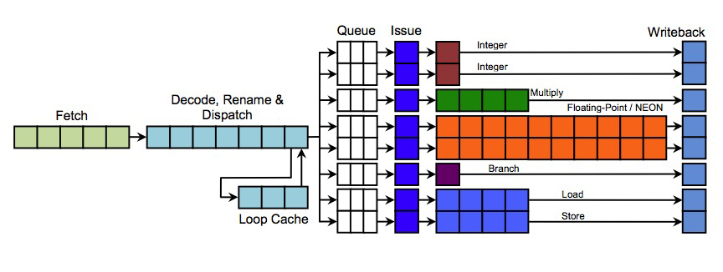
Issue Queues and Execution Lanes
ARM Cortex A15
Source: theregister.co.uk
Notes:
Distributed, with localized control (easy win: break up based on data type, I.e. FP vs. integer)
Less efficient utilization, but each unit is smaller since can be single-ported (for dispatch and issue)
Must tune for proper utilization

Slide 35
Program Data Dependences
True dependence (RAW)
  j cannot execute until i produces its result
Anti-dependence (WAR)
  j cannot write its result until i has read its sources
Output dependence (WAW)
  j cannot write its result until i has written its result

Slide 36
Register Data Dependences
Program data dependences cause hazards
  True dependences (RAW)
  Antidependences (WAR)
  Output dependences (WAW)
When are registers read and written?
  Out of program order to extract maximum ILP
  Hence, any and all of these can occur
Solution to all three: register renaming

Slide 37
Register Renaming: WAR/WAW
Widely employed (Core i7, Cortex A15, …)
Resolving WAR/WAW:
  Each register write gets unique “rename register”
  Writes are committed in program order at Writeback
  WAR and WAW are not an issue
    All updates to “architected state” delayed till writeback
    Writeback stage always later than read stage
  Reorder Buffer (ROB) enforces in-order writeback
Add R3 <= … P32 <= …
Sub R4 <= … P33 <= …
And R3 <= … P35 <= …

Slide 38
Register Renaming: RAW
In order, at dispatch:
  Source registers checked to see if “in flight”
    Register map table keeps track of this
    If not in flight, can be read from the register file
    If in flight, look up “rename register” tag (IOU)
  Then, allocate new register for register write
Add R3 <= R2 + R1 P32 <= P2 + P1
Sub R4 <= R3 + R1 P33 <= P32 - P1
And R3 <= R4 & R2 P35 <= P33 & P2

Slide 39
Register Renaming: RAW
Advance instruction to instruction queue
  Wait for rename register tag to trigger issue
Issue queue/reservation station enables out-of-order issue
  Newer instructions can bypass stalled instructions
Source: theregister.co.uk

Slide 40
Instruction scheduling
A process of mapping a series of instructions into execution resources
  Decides when and where an instruction is executed
Data dependence graph
Mapped to two FUs
FU0
FU1
1
n
1
2
3
4
n+1
2
3
5
6
n+2
5
4
n+3
6

Slide 41
Instruction scheduling
A set of wakeup and select operations
  Wakeup
    Broadcasts the tags of parent instructions selected
    Dependent instruction gets matching tags, determines if source operands are ready
    Resolves true data dependences
  Select
    Picks instructions to issue among a pool of ready instructions
    Resolves resource conflicts
      Issue bandwidth
      Limited number of functional units / memory ports

Slide 42
Scheduling loop
Basic wakeup and select operations
broadcast the tag
of the selected inst
tag W
…
tag 1
grant 0
request 0
OR
=
=
OR
scheduling
loop
=
=
grant 1
request 1
readyL
tagL
tagR
readyR
…
…
……
OR
=
=
OR
=
=
grant n
selected
readyL
tagL
tagR
readyR
issue
to FU
request n
ready - request
Select logic
Wakeup logic

Slide 43
Wakeup and Select
Ready inst
to issue
Wakeup /
select
FU0
FU1
1
Select 1
Wakeup 2,3,4
n
1
1
2
3
4
Select 2, 3
Wakeup 5, 6
n+1
2
3
2, 3, 4
5
6
Select 4, 5
Wakeup 6
n+2
5
4
4, 5
n+3
6
6
Select 6

Slide 44
High-IPC Processor

Slide 45
Memory Data Flow
Resolve WAR/WAW/RAW memory dependences
  MEM stage can occur out of order
Provide high bandwidth to memory hierarchy
  Non-blocking caches

Slide 46
Memory Data Dependences
Load/Store RS
Agen
Mem
WAR/WAW: stores commit in order
  Hazards not possible.
RAW: loads must check pending stores
  Store queue keeps track of pending stores
  Loads check against these addresses
  Similar to register bypass logic
  Comparators are 64 bits wide
  Must consider position (age) of loads and stores
Major source of complexity in modern designs
  Store queue lookup is position-based
  What if store address is not yet known?
Store
Queue
Reorder Buffer

Slide 47
Optimizing Load/Store Disambiguation
Non-speculative load/store disambiguation
  Loads wait for addresses of all prior stores
  Full address comparison
  Bypass if no match, forward if match
(1) can limit performance:
load r5,MEM[r3] ← cache miss
store r7, MEM[r5] ← RAW for agen, stalled
…
load r8, MEM[r9] ← independent load stalled

Slide 48
Speculative Disambiguation
What if aliases are rare?
  Loads don’t wait for addresses of all prior stores
  Full address comparison of stores that are ready
  Bypass if no match, forward if match
  Check all store addresses when they commit
    No matching loads – speculation was correct
    Matching unbypassed load – incorrect speculation
  Replay starting from incorrect load
Load/Store RS
Agen
Mem
Load
Queue
Store
Queue
Reorder Buffer

Slide 49
Speculative Disambiguation: Load Bypass
i1: st R3, MEM[R8]: ??
i2: ld R9, MEM[R4]: ??
Agen
Mem
Load
Queue
Store
Queue
i2: ld R9, MEM[R4]: x400A
i1: st R3, MEM[R8]: x800A
Reorder Buffer
i1 and i2 issue in program order
i2 checks store queue (no match)

Slide 50
Speculative Disambiguation: Load Forward
i1: st R3, MEM[R8]: ??
i2: ld R9, MEM[R4]: ??
Agen
Mem
Load
Queue
Store
Queue
i2: ld R9, MEM[R4]: x800A
i1: st R3, MEM[R8]: x800A
Reorder Buffer
i1 and i2 issue in program order
i2 checks store queue (match=>forward)

Slide 51
Speculative Disambiguation: Safe Speculation
i1: st R3, MEM[R8]: ??
i2: ld R9, MEM[R4]: ??
Agen
Mem
Load
Queue
Store
Queue
i2: ld R9, MEM[R4]: x400C
i1: st R3, MEM[R8]: x800A
Reorder Buffer
i1 and i2 issue out of program order
i1 checks load queue at commit (no match)

Slide 52
Speculative Disambiguation: Violation
i1: st R3, MEM[R8]: ??
i2: ld R9, MEM[R4]: ??
Agen
Mem
Load
Queue
Store
Queue
i2: ld R9, MEM[R4]: x800A
i1: st R3, MEM[R8]: x800A
Reorder Buffer
i1 and i2 issue out of program order
i1 checks load queue at commit (match)
  i2 marked for replay

Slide 53
Increasing Memory Bandwidth
Expensive to duplicate
Notes:
Duplicating load/store pipelines is fundamentally harder because they contain shared state (in the cache)
Loads that miss can be set aside in a “missed load buffer” or “miss status handling register” (MSHR)
Subsequent loads that hit can still be handled

Slide 54
True Multiporting of SRAM
“Bit” Lines
-carry data in/out
“Word” Lines
-select a row

Slide 55
Increasing Memory Bandwidth
Complex, concurrent FSMs
Notes:
Duplicating load/store pipelines is fundamentally harder because they contain shared state (in the cache)
Loads that miss can be set aside in a “missed load buffer” or “miss status handling register” (MSHR)
Subsequent loads that hit can still be handled

Slide 56
Miss Status Handling Register
Address
Victim
LdTag
State
V[0:3]
Data
Address
Victim
LdTag
State
V[0:3]
Data
Address
Victim
LdTag
State
V[0:3]
Data
Address
Victim
LdTag
State
V[0:3]
Data
Each MSHR entry keeps track of:
  Address: miss address
  Victim: set/way to replace
  LdTag: which load (s) to wake up
  State: coherence state, fill status
  V[0:3]: subline valid bits
  Data: block data to be filled into cache

Slide 57
Coherent Memory Interface

Slide 58
Coherent Memory Interface
Load Queue
  Tracks inflight loads for aliasing, coherence
Store Queue
  Defers stores until commit, tracks aliasing
Storethrough Queue or Write Buffer or Store Buffer
  Defers stores, coalesces writes, must handle RAW
MSHR
  Tracks outstanding misses, enables lockup-free caches [Kroft ISCA 91]
Snoop Queue
  Buffers, tracks incoming requests from coherent I/O, other processors
Fill Buffer
  Works with MSHR to hold incoming partial lines
Writeback Buffer
  Defers writeback of evicted line (demand miss handled first)

Slide 59
Split Transaction Bus
“Packet switched” vs. “circuit switched”
Release bus after request issued
Allow multiple concurrent requests to overlap memory latency
Complicates control, arbitration, and coherence protocol
  Transient states for pending blocks (e.g. “req. issued but not completed”)

Slide 60
Memory Consistency
How are memory references from different processors interleaved?
If this is not well-specified, synchronization becomes difficult or even impossible
  ISA must specify consistency model
Common example using Dekker’s algorithm for synchronization
  If load reordered ahead of store (as we assume for a baseline OOO CPU)
  Both Proc0 and Proc1 enter critical section, since both observe that other’s lock variable (A/B) is not set
If consistency model allows loads to execute ahead of stores, Dekker’s algorithm no longer works
  Common ISAs allow this: IA-32, PowerPC, SPARC, Alpha

Slide 61
Sequential Consistency [Lamport 1979]
Processors treated as if they are interleaved processes on a single time-shared CPU
All references must fit into a total global order or interleaving that does not violate any CPU’s program order
  Otherwise sequential consistency not maintained
Now Dekker’s algorithm will work
Appears to preclude any OOO memory references
  Hence precludes any real benefit from OOO CPUs

Slide 62
High-Performance Sequential Consistency
Coherent caches isolate CPUs if no sharing is occurring
  Absence of coherence activity means CPU is free to reorder references
Still have to order references with respect to misses and other coherence activity (snoops)
Key: use speculation
  Reorder references speculatively
  Track which addresses were touched speculatively
  Force replay (in order execution) of such references that collide with coherence activity (snoops)

Slide 63
High-Performance Sequential Consistency
Load queue records all speculative loads
Bus writes/upgrades are checked against LQ
Any matching load gets marked for replay
At commit, loads are checked and replayed if necessary
  Results in machine flush, since load-dependent ops must also replay
Practically, conflicts are rare, so expensive flush is OK

Slide 64
Maintaining Precise State
ROB
Out-of-order execution
  ALU instructions
  Load/store instructions
In-order completion/retirement
  Precise exceptions
Solutions
  Reorder buffer retires instructions in order
  Store queue retires stores in order
  Exceptions can be handled at any instruction boundary by reconstructing state out of ROB/SQ
Head
Tail
Notes:
Precise exception – clean instr. Boundary for restart
Memory consistency – WAW, also subtle multiprocessor issues (in 757)
Memory coherence – RAR expect later load to also see new value seen by earlier load

Slide 65
Summary: A High-IPC Processor

Slide 66
[John DeVale & Bryan Black, 2005]

Slide 67
Review of 752
Iron law
Superscalar challenges
  Instruction flow
  Register data flow
  Memory Dataflow
Modern memory interface
What was not covered
  Memory hierarchy (review later)
  Virtual memory
  Power & reliability
  Many implementation/design details
  Etc.
  Multithreading (coming up later)

