Slide 1
ECE/CS 757: Advanced Computer Architecture II SIMD
Instructor:Mikko H Lipasti
Spring 2017
University of Wisconsin-Madison
Lecture notes based on slides created by John Shen, Mark Hill, David Wood, Guri Sohi, Jim Smith, Natalie Enright Jerger, Michel Dubois, Murali Annavaram, Per Stenström and probably others

Slide 2
SIMD & MPP Readings
Read: [20] C. Hughes, “Single-Instruction Multiple-Data Execution,” Synthesis Lectures on Computer Architecture, http://www.morganclaypool.com/doi/abs/10.2200/S00647ED1V01Y201505CAC032
Review: [21] Steven L. Scott, Synchronization and Communication in the T3E Multiprocessor, Proceedings of International Conference on Architectural Support for Programming Languages and Operating Systems, pages 26-36, October 1996.

Slide 3
Lecture Outline
SIMD introduction
Automatic Parallelization for SIMD machines
Vector Architectures
Cray-1 case study

Slide 4
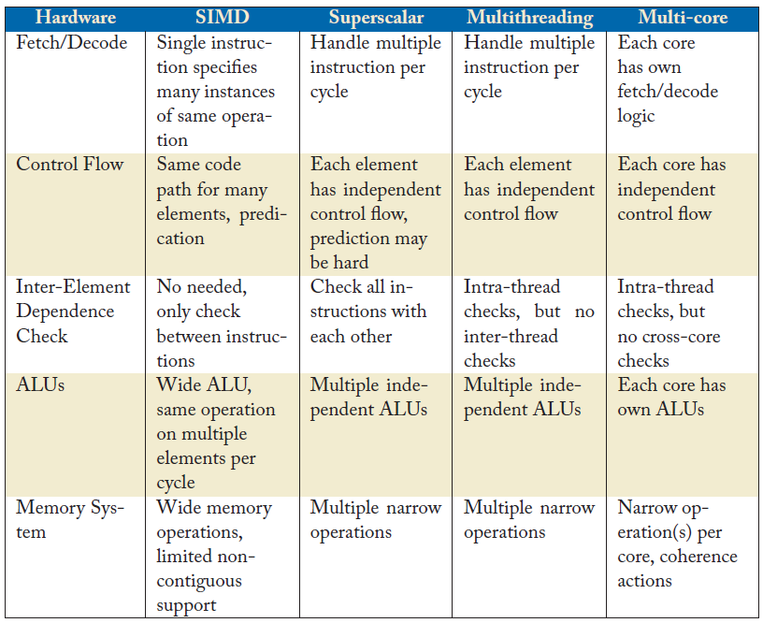
SIMD vs. Alternatives
From [Hughes, SIMD Synthesis Lecture]

Slide 5
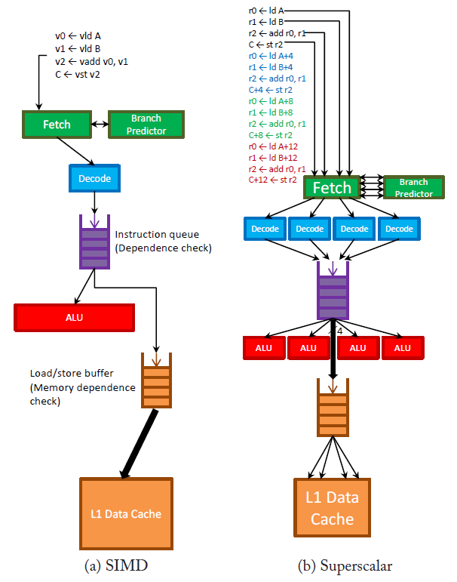
SIMD vs. Superscalar
From [Hughes, SIMD Synthesis Lecture]

Slide 6
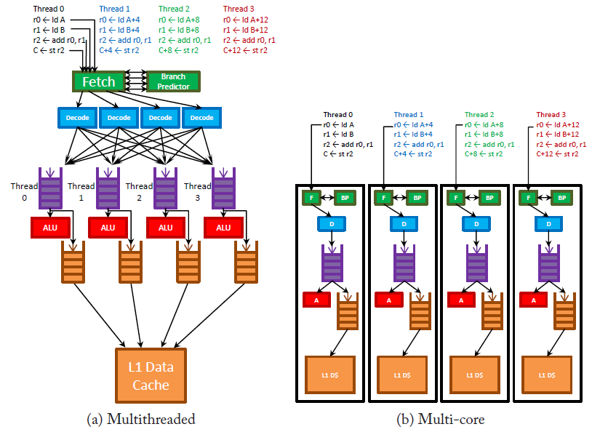
Multithreaded vs. Multicore
From [Hughes, SIMD Synthesis Lecture]

Slide 7
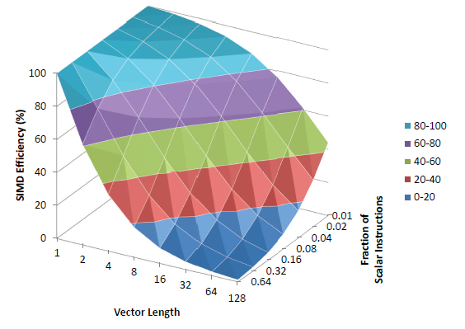
SIMD Efficiency
From [Hughes, SIMD Synthesis Lecture]
Amdahl’s Law…

Slide 8
SIMD History
Vector machines, supercomputing
Illiac IV, CDC Star-100, TI ASC,
Cray-1: properly architected (by Cray-2 gen)
Incremental adoption in microprocessors
Intel Pentium MMX: vectors of bytes
Subsequently: SSEx/AVX-y, now AVX-512
Also SPARC, PowerPC, ARM, …
Improperly architected…
Also GPUs from AMD/ATI and Nvidia (later)

Slide 9
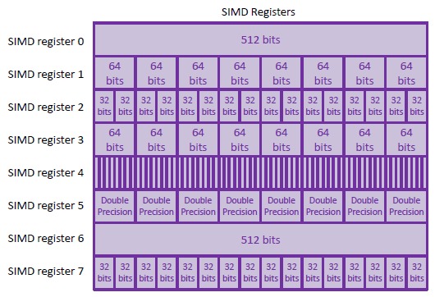
Register Overlays
From [Hughes, SIMD Synthesis Lecture]

Slide 10
SIMD Challenges
Remainders
Fixed vector length, software has to fix up
Properly architected: VL is supported in HW
Control flow deviation
Conditional behavior in loop body
Properly architected: vector masks
Memory access
Alignment restrictions
Virtual memory, page faults (completion masks)
Irregular accesses: properly architected gather/scatter
Dependence analysis (next)

Slide 11
Lecture Outline
SIMD introduction
Automatic Parallelization for SIMD machines
Vector Architectures
Cray-1 case study

Slide 12
Automatic Parallelization
Start with sequential programming model
Let the compiler attempt to find parallelism
It can be done…
We will look at one of the success stories
Commonly used for SIMD computing – vectorization
Useful for MIMD systems, also -- concurrentization
Often done with FORTRAN
But, some success can be achieved with C
(Compiler address disambiguation is more difficult with C)

Slide 13
Automatic Parallelization
Consider operations on arrays of data
do I=1,N
A(I,J) = B(I,J) + C(I,J)
end do
Operations along one dimension involve vectors
Loop level parallelism
Do all – all loop iterations are independent
Completely parallel
Do across – some dependence across loop iterations
Partly parallel
A(I,J) = A(I-1,J) + C(I,J) * B(I,J)

Slide 14
Data Dependence
Independence ⇒ Parallelism
OR, dependence inhibits parallelism
S1: A=B+C
S2: D=A+2
S3: A=E+F
True Dependence (RAW):
S1 δ S2
Antidependence (WAR):
S2 δ⁻ S3
Output Dependence (WAW):
S1 δº S3

Slide 15
Data Dependence Applied to Loops
Similar relationships for loops
But consider iterations
do I=1,2
S1: A(I)=B(I)+C(I)
S2: D(I)=A(I)
end do
S1 δ₌ S2
Dependence involving A, but on same loop iteration

Slide 16
Data Dependence Applied to Loops
S1 δ< S2
do I=1,2
S1: A(I)=B(I)+C(I)
S2: D(I)=A(I-1)
end do
Dependence involving A, but read occurs on next loop iteration
Loop carried dependence
S2 δ⁻< S1
Antidependence involving A, write occurs on next loop iteration
do I=1,2
S1: A(I)=B(I)+C(I)
S2: D(I)=A(I+1)
end do

Slide 17
Loop Carried Dependence
Definition
do I = 1, N
S1: X(f(i)) = F(...)
S2: A = X(g(i)) ...
end do
S1 δ S2 : is loop-carried
if there exist i₁, i₂ where
1≤ i₁ < i₂ ≤ N and f(i₁) = g(i₂ )
If f and g can be arbitrary functions, the problem is essentially unsolvable.
However, if (for example)
f(i) = c*I + j and g(i) = d*I + k
there are methods for detecting dependence.

Slide 18
Loop Carried Dependences
GCD test
do I = 1, N
S1: X(c*I + j ) = F(...)
S2: A = X(d*I + k) ...
end do
f(x) = g(y) if c*I + j = d*I + k
This has a solution iff gcd(c, d ) | k- j
Example
A(2*I) =
= A(2*I +1)
GCD(2,2) does not divide 1 - 0
The GCD test is of limited use because it is very conservative
often gcd(c,d) = 1
X(4i+1) = F(X(5i+2))
Other, more complex tests have been developed
e.g. Banerjee's Inequality, polyhedral analysis

Slide 19
Vector Code Generation
In a vector architecture, a vector instruction performs identical operations on vectors of data
Generally, the vector operations are independent
A common exception is reductions (horizontal ops)
In general, to vectorize:
There should be no cycles in the dependence graph
Dependence flows should be downward
⇒ some rearranging of code may be needed.

Slide 20
Vector Code Generation: Example
do I = 1, N
S1: A(I) = B(I)
S2: C(I) = A(I) + B(I)
S3: E(I) = C(I+1)
end do
Construct dependence graph
S1:
δ
S2:
δ⁻
S3:
Vectorizes (after re-ordering S2: and S3: due to antidependence)
S1: A(I:N) = B(I:N)
S3: E(I:N) = C(2:N+1)
S2: C(I:N) = A(I:N) + B(I:N)

Slide 21
Multiple Processors (Concurrentization)
Often used on outer loops
Example
do I = 1, N
do J = 2, N
S1: A(I,J) = B(I,J) + C(I,J)
S2: C(I,J) = D(I,J)/2
S3: E(I,J) = A(I,J-1)**2 + E(I,J-1)
end do
end do
Data Dependences & Directions
S1 δ_{=, <} S3
S1 δ_{=, =} S2
S3 δ_{=, <} S3
Observations
All dependence directions for I loop are =
⇒ Iterations of the I loop can be scheduled in parallel

Slide 22
Scheduling
Data Parallel Programming Model
SPMD (single program, multiple data)
Compiler can pre-schedule:
Processor 1 executes 1st N/P iterations,
Processor 2 executes next N/P iterations
Processor P executes last N/P iterations
Pre-scheduling is effective if execution time is nearly identical for each iteration
Self-scheduling is often used:
If each iteration is large
Time varies from iteration to iteration
iterations are placed in a "work queue”
a processor that is idle, or becomes idle takes the next block of work from the queue (critical section)

Slide 23
Code Generation with Dependences
do I = 2, N
S1: A(I) = B(I) + C(I)
S2: C(I) = D(I) * 2
S3: E(I) = C(I) + A(I-1)
end do
Data Dependences & Directions
S1 δ⁻₌ S2
S1 δ< S3
S2 δ₌ S3
Parallel Code on N-1 Processors
S1: A(I) = B(I) + C(I)
signal(I)
S2: C(I) = D(I) * 2
if (I > 2) wait(I-1)
S3: E(I) = C(I) + A(I-1)
Observation
Weak data-dependence tests may add unnecessary synchronization.
⇒Good dependence testing crucial for high performance

Slide 24
Reducing Synchronization
do I = 1, N
S1: A(I) = B(I) + C(I)
S2: D(I) = A(I) * 2
S3: SUM = SUM + A(I)
end do
Parallel Code: Version 1
do I = p, N, P
S1: A(I) = B(I) + C(I)
S2: D(I) = A(I) * 2
if (I > 1) wait(I-1)
S3: SUM = SUM + A(I)
signal(I)
end do

Slide 25
Reducing Synchronization, contd.
Parallel Code: Version 2
SUMX(p) = 0
do I = p, N, P
S1: A(I) = B(I) + C(I)
S2: D(I) = A(I) * 2
S3: SUMX(p) = SUMX(p) + A(I)
end do
barrier synchronize
add partial sums
Not always safe (bit-equivalent): why?

Slide 26
Vectorization vs Concurrentization
When a system is a vector MP, when should vector/concurrent code be generated?
do J = 1,N
do I = 1,N
S1: A(I,J+1) = B(I,J) + C(I,J)
S2: D(I,J) = A(I,J) * 2
end do
end do
Parallel & Vector Code: Version 1
doacross J = 1,N
S1: A(1:N,J+1) = B(1:N,J)+C(1:N,J)
signal(J)
if (J > 1) wait (J-1)
S2: D(1:N,J) = A(1:N,J) * 2
end do

Slide 27
Vectorization vs Concurrentization
Parallel & Vector Code: Version 2
Vectorize on J, but non-unit stride memory access
(assuming Fortran Column Major storage order)
doall I = 1,N
S1: A(I,2:N+1) = B(I,1:N) + C(I,1:N)
S2: D(I,1:N) = A(I,1:N) * 2
end do
Need support for gather/scatter

Slide 28
Summary
Vectorizing compilers have been a success
Dependence analysis is critical to any auto-parallelizing scheme
Software (static) disambiguation
C pointers are especially difficult
Can also be used for improving performance of sequential programs
Loop interchange
Fusion
Etc.

Slide 29
Aside: Thread-Level Speculation
Add hardware to resolve difficult concurrentization problems
Memory dependences
Speculate independence
Track references (cache versions, r/w bits, similar to TM)
Roll back on violations
Thread/task generation
Dynamic task generation/spawn (Multiscalar)
References
Gurindar S. Sohi , Scott E. Breach , T. N. Vijaykumar, Multiscalar processors, Proceedings of the 22nd annual international symposium on Computer architecture, p.414-425, June 22-24, 1995
J. Steffan , T Mowry, The Potential for Using Thread-Level Data Speculation to Facilitate Automatic Parallelization, Proceedings of the 4th International Symposium on High-Performance Computer Architecture, p.2, January 31-February 04, 1998

Slide 30
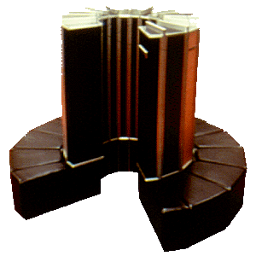
Cray-1 Architecture
Circa 1976
80 MHz clock
When high performance mainframes were 20 MHz
Scalar instruction set
16/32 bit instruction sizes
Otherwise conventional RISC
8 S register (64-bits)
8 A registers (24-bits)
In-order pipeline
Issue in order
Can complete out of order (no precise traps)

Slide 31
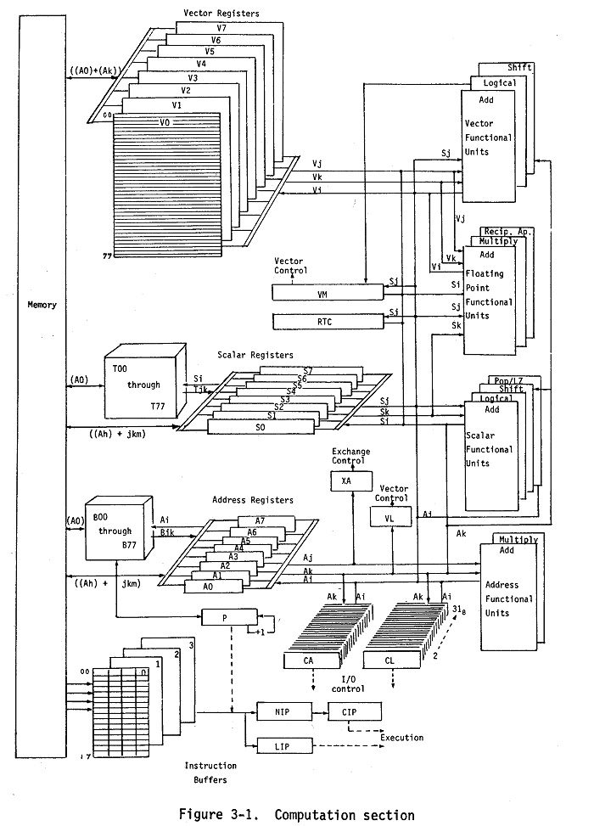
Cray-1 Vector ISA
8 vector registers
64 elements
64 bits per element (word length)
Vector length (VL) register
RISC format
Vi ← Vj OP Vk
Vi ← mem(Aj, disp)
Conditionals via vector mask (VM) register
VM ← Vi pred Vj
Vi ← V2 conditional on VM

Slide 32
Vector Example
Do 10 i=1,looplength
a(i) = b(i) * x + c(i)
10 continue
A1 ← looplength .initial values:
A2 ← address(a) .for the arrays
A3 ← address(b) .
A4 ← address(c) .
A5 ← 0 .index value
A6 ← 64 .max hardware VL
S1 ← x .scalar x in register S1
VL ← A1 .set VL – performs mod function
.
BrC done, A1<=0 .branch if nothing to do
more: V3 ← A4,A5 .load c indexed by A5 – addr mode not in Cray-1
V1 ← A3,A5 .load b indexed by A5
V2 ← V1 * S1 .vector times scalar
V4 ← V2 + V3 .add in c
A2,A5 ← V4 .store to a indexed by A5
A7 ← VL .read actual VL
A1 ← A1 – A7 .remaining iteration count
A5 ← A5 + A7 .increment index value
VL ← A6 . set VL for next iteration
BrC more, A1>0 .branch if more work
done:

Slide 33
Compare with Scalar
Do 10 i=1,looplength
a(i) = b(i) * x + c(i)
10 continue
2 loads
1 store
2 FP
1 branch
1 index increment (at least)
1 loop count increment
total -- 8 instructions per iteration
4-wide superscalar => up to 1 FP op per cycle
vector, with chaining => up to 2 FP ops per cycle (assuming mem b/w)
Also, in a CMOS microprocessor would save a lot of energy
.

Slide 34
Vector Conditional Loop
do 80 i = 1,looplen
if (a(i).eq.b(i)) then
c(i) = a(i) + e(i)
endif
80 continue
V1 ← A1 .load a(i)
V2 ← A2 .load b(i)
VM ← V1 == V2 .compare a and b; result to VM
V3 ← A3; VM .load e(i) under mask
V4 ← V1 + V3; VM .add under mask
A4 ← V4; VM .store to c(i) under mask

Slide 35
Vector Conditional Loop
Gather/Scatter Method (used in later Cray machines)
do 80 i = 1,looplen
if (a(i).eq.b(i)) then
c(i) = a(i) + e(i)
endif
80 continue
V1 ← A1 .load a(i)
V2 ← A2 .load b(i)
VM ← V1 == V2 .compare a and b; result to VM
V5 ← IOTA(VM) .form index set
VL ← pop(VM) .find new VL (population count)
V6 ← A1, V5 .gather a(i) values
V3 ← A3, V5 .gather e(i) values
V4 ← V6 + V3 .add a and e
A4,V11 ← V4 .scatter sum into c(i)

Slide 36
Lecture Summary
SIMD introduction
Automatic Parallelization
Vector Architectures
Cray-1 case study

