Slide 1
PInterNet Where multi core simulation becomes network aware
Team Members: Simon Xu, Preyas Shah, Rahul Nayar, Fan Wu

Slide 2
Outline
Motivation
Design Overview
ZSim- Overview, Infrastructure and Modifications
Router- Micro-architecture and Implementation
BookSim - Overview, Infrastructure and Modifications
Results
Open Issues/Future Work
Conclusions
A vote of thanks – Cheers!!!!

Slide 3
Motivation
PInterNet
Can We do something about it?
This is why 757 has project component
Awesome, What's the catch?
There are many, but we pick this one:
Does not support NOC – remains future work since 2013
ZSIM
1500 MIPS for Simple Cores, 300 for OOO cores
Within15% accurate of real systems
Issues with Multi Core Simulation
Sequential – extremely slow
Scale poorly or not accurate

Slide 4
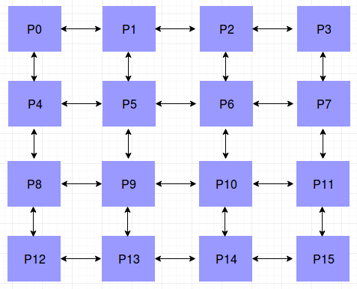
Design Overview
Accelerator Processing Unit
Processing Units
16 partitions
8 Cores/partition
128 Cores
Memory
8KB 2 way L1 I$
16KB 2 way L1 D$
Network
128KB 4 way L2 shared
4x4 Mesh
5 links
2 stage Router
RISCV cores
Weak Consistency Model

Slide 5
ZSim – why do we love it and hate it?
What makes it faster?
Instruction Driven Timing Models – dynamic binary translation
Bound and Weave Phase
Virtualized system view
Which kind of cores does it support?
Beefy Core – Westemere microarch
Wimpy Core – single IPC core model
Bound Phase
One host thread per simulated core - || execution
Event Trace for misses beyond trace hierarchy
Weave Phase
Event queue simulation in-order
Divide system into domains – each domain has own priority queue
Faster
Report domain crossings
Limitation on fine-grained messaging
Weave phase is network congestion oblivious

Slide 6
ZSim – Bound and Weave Phase
Bound Phase Execution
Synchronize all the Threads
Update all Memory reference in a Queue
Weave Phase Execution
Synchronize all the Threads
Dequeue all Memory references and apply latency Panelties

Slide 7
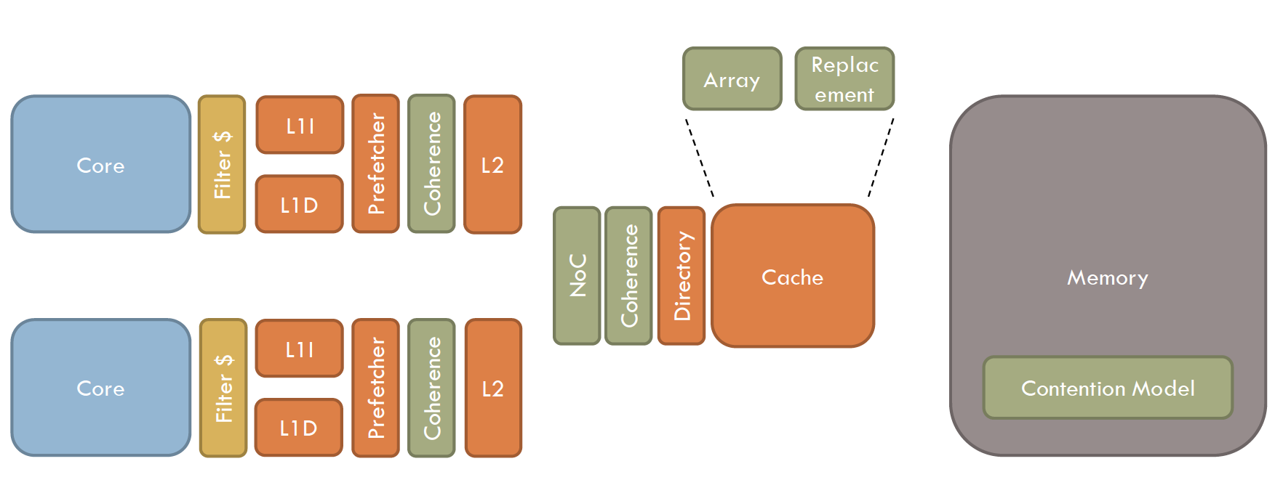
ZSim Modeling overview
Not Using It
Courtesy: ZSim Authors

Slide 8
ZSim – current configuration
Partitioned Memory
8 Wimpy core + L1$
8 Wimpy core + L1$
8 Wimpy core + L1$
8 Wimpy core + L1$
8 Wimpy core + L1$
8 Wimpy core + L1$
8 Wimpy core + L1$
8 Wimpy core + L1$
8 Wimpy core + L1$
8 Wimpy core + L1$
8 Wimpy core + L1$
8 Wimpy core + L1$
8 Wimpy core + L1$
8 Wimpy core + L1$
8 Wimpy core + L1$
8 Wimpy core + L1$
Beefy OOO Core
Thread Scheduling
Issues with this modeling:
Oblivious of Bound and Weave Phase
Unaware of Network Congestion
No phase wise tracking of all Out Of Partition accesses
Constant penalty to all Out Of Partition accesses

Slide 9
ZSim Modifications
Partitioned Memory
8 Wimpy core + L1$
8 Wimpy core + L1$
8 Wimpy core + L1$
8 Wimpy core + L1$
8 Wimpy core + L1$
8 Wimpy core + L1$
8 Wimpy core + L1$
8 Wimpy core + L1$
8 Wimpy core + L1$
8 Wimpy core + L1$
8 Wimpy core + L1$
8 Wimpy core + L1$
8 Wimpy core + L1$
8 Wimpy core + L1$
8 Wimpy core + L1$
8 Wimpy core + L1$
Beefy OOO Core
Thread Scheduling
Modifications:
Keep track of all OOPs in Bound Phase
Sync Barries between Bound and Weave
BookSim to calculate latency penalty based on OOPs of last bound phase
Latency penalization to Cores in Weave Phase
L2$ mimic in Weave Phase
Issues:
Oblivious of Bound and Weave Phase
Unaware of Network Congestion
No phase wise tracking of all OOP accesses
Constant penalty to all OOP accesses

Slide 10
PInterNet Router Overview
Testing Framework
Design Goal
Easy to design :p
High Performance
Low latency/high throughput
Optimize for real workloads
Synthesizable and fast
Highly Parameterizable
Chisel has good parameterization support
Peek-Poke Tester
Chisel (Scala-based)
FIRRTL
Verilog
Unit test Verification
Performance Eval
Synopsys Design Compiler

Slide 11
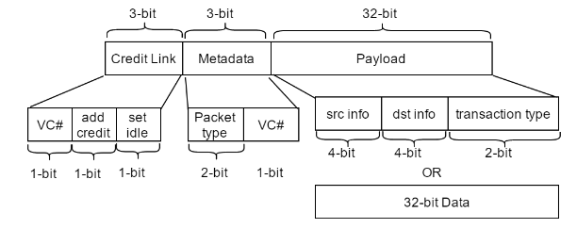
PInterNet Router Specs
Mesh Network (5-in-5-out)
Cut-Through
Credit Based Flow Control
XY-Routing
Virtual Channel
two-cycle Latency
Fully Parameterizable
Hit 1GHz Freq @ ARM 55nm
Flit Structure (assuming 32-bit bus)

Slide 12
PInterNet Router Microarchitecture
N
N
S
S
E
E
W
W
Local
Local

Slide 13
PInterNet Router Microarchitecture
Input Units
(Routing Calculation,
1st-level Arbitration
Data Buffering)
Distributed
VC Allocator
Switch Allocator
(2nd-level Arbitration,
VC assignment,
Routing Resource Allocation,
Deadlock Prevention)
Output Units
(Credit Stats,
Credit/Channel Release signaling,
Buffering)
N
N
Hierarchical arbitration: helps relieve timing constraints
Static routing and RR-policy achieves deadlock prevention
Distributed allocators: simplify the design while maintain good throughput
S
S
E
E
W
W
Local
Local

Slide 14
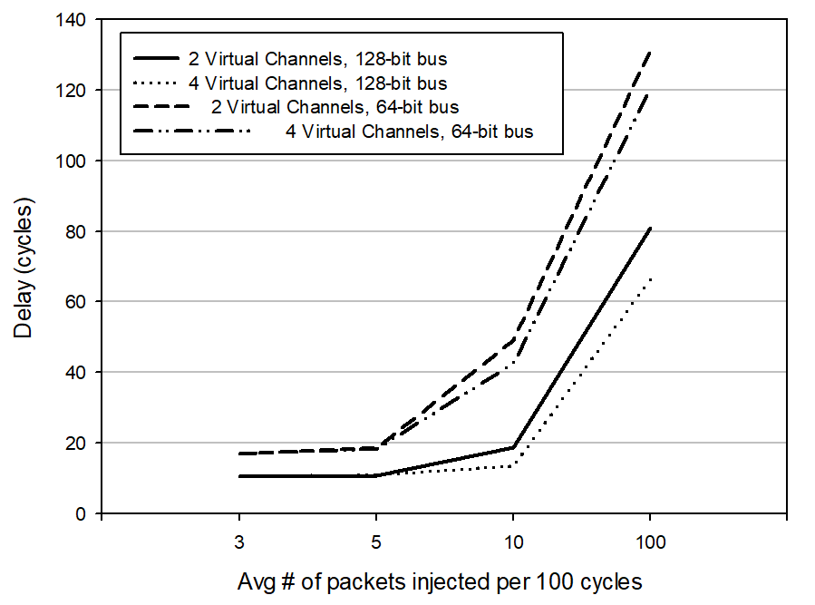
Performance Evaluation
Heavily loaded—exponential growth
What do real-life workloads suggest?
VertexCover:
<5 OOPs/100cycles/router
WordCount:
<1 OOPs/100cycles/router
PageRank (Peak):
~25 OOPs/100cycles/router
Optimize for common cases and let uncommon cases fail gracefully
Lightly loaded—close to ideal

Slide 15
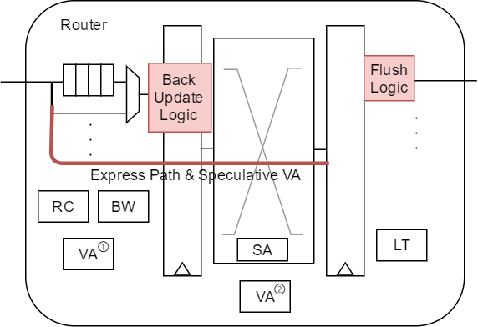
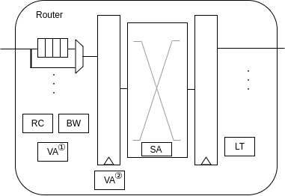
One Step Further – A Single-Cycle Router
Non-intrusive bypassing route
Light-weight Speculation Logic
Zero-cycle penalty on mis-speculation

Slide 16
Performance Evaluation (2)
2 Virtual Channels
128-bit bus
VA speculation
~perf of design without speculation
~-20%
~perf of 4VCs

Slide 17
BookSim Overview
Cycle-accurate network simulator for demonstration purposes
Supports various networks, including ring, mesh, and torus
Packets are generated randomly given injection rate
Does not allow the use of custom trace

Slide 18
Zsim & BookSim Integration
Problem 1: BookSim does not allow the injection of a custom trace
Solution: Replace the random packet generation logic with one that reads the trace file generated by Zsim
Problem 2: We need a way to integrate BookSim and Zsim.
Solution: Create a shared booksimapi.hpp header that provides API to be called from Zsim. Through the API, Zsim can supply trace file to BookSim and control its execution.
Problem 3: For read access, Zsim only issues a read request; In real situations, there is also a read response.
Solution: In BookSim, upon the delivery of a read request, a read response is injected a few cycles later.

Slide 19
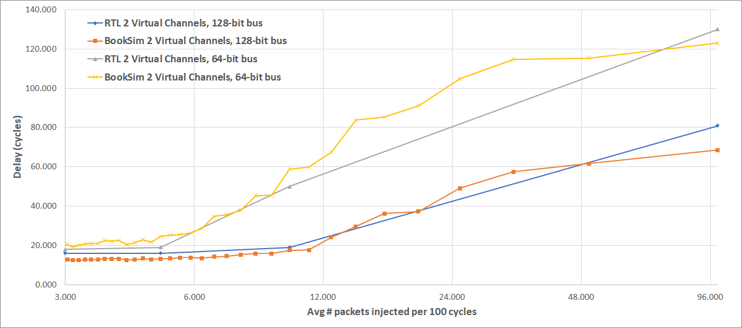
BookSim Router Implementation
We modified the canonical 5-stage router in BookSim to mimic the 2-stage router in our RTL design.

Slide 20
Results
Workloads used for testing the infrastructure
Histogram
Wordcount
VertexCover
PageRank

Slide 21
Workload
Histogram:
Make no OOP load/store access
Most of the accesses are focused on the same partition
Used to check the change in simulation time for PInterNet for interconnect is not accessed
Wordcount:
Moderate amount of OOP load access, no OOP stores
Used this to check the initial setup of our PInternet, and gain confidence if our zsim + bookism infrastructure that is working
Vertexcover:
Large amount of OOP load access with no stores
Testing our PInternet setup
Pagerank
Large OOP load and store access comes from this workload
OOP load and store access are distributed across different partition
Use this workload to do the uniform testing of the mesh interconnect system

Slide 22
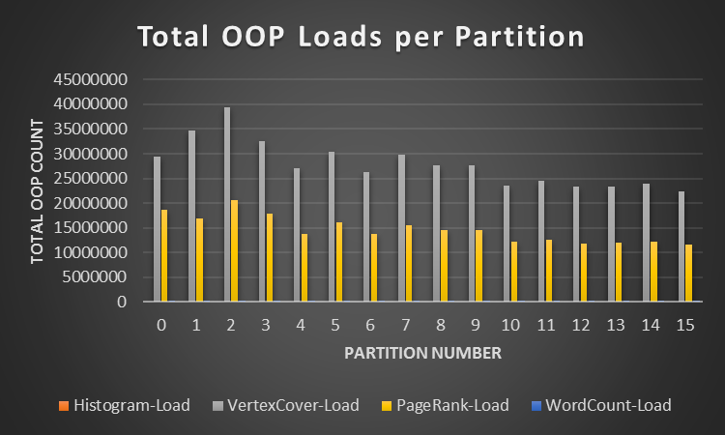
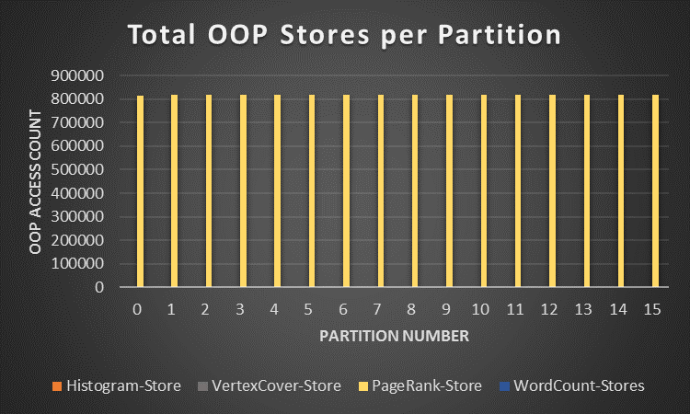
Workload Characteristics
Notes:
Histogram
Make no OOP load/store access
Most of the access are focused on the same core/partition
Since we have used the bookism for mesh interconnect setup, this workload will be convince us that we are not increasing the simulation time in PinterNet when no OOP access is made
Wordcount
Moderate amount of OOP load access no OOP stores
Used this to check the initial setup of our Pinternet, and gain confidence if our zsim + bookism infrastructure that is working
Vertexcover
Large amount of OOP load access with no stores
Wordcount
Moderate amount of OOP load access no OOP stores
Used this to check the initial setup of our Pinternet, and gain confidence if our zsim + bookism infrastructure that is working
Pagerank
Most OOP load and store access comes from this workload
OOP load and store access are distributed across different partition
We use this workload to do the uniform testing of the mesh interconnect system

Slide 23
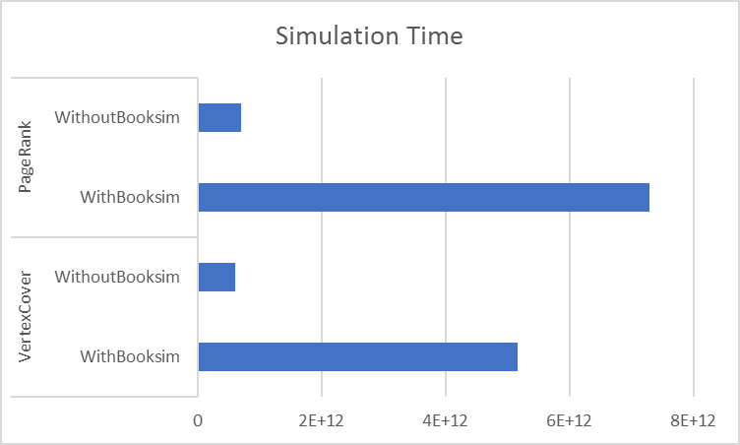
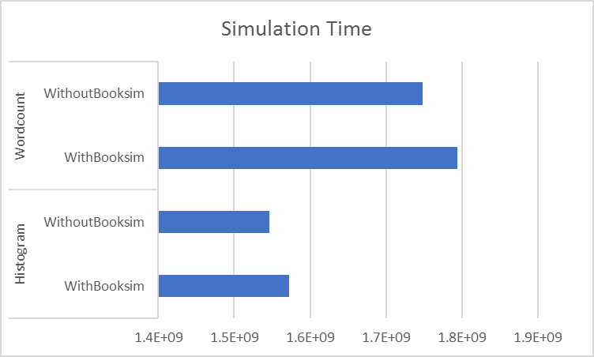
Simulation time with/without booksim
*Values extrapolated for PageRank and VertexCover

Slide 24
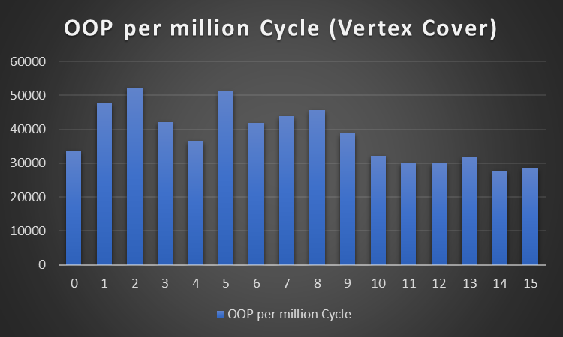
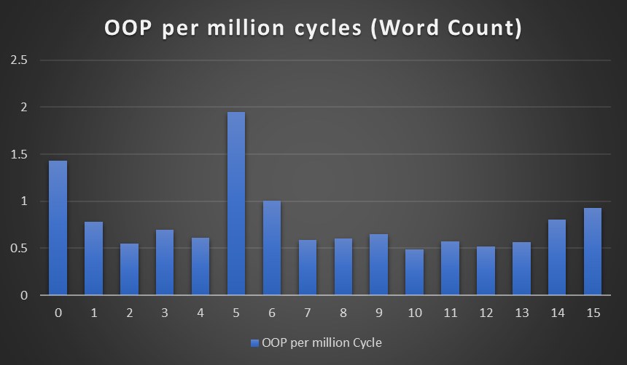
OOP per Cycle

Slide 25
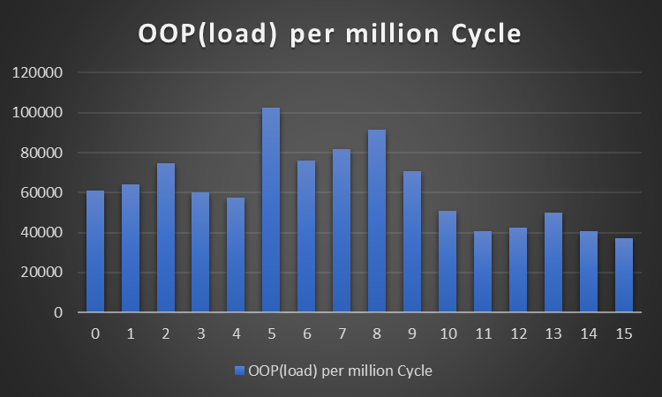
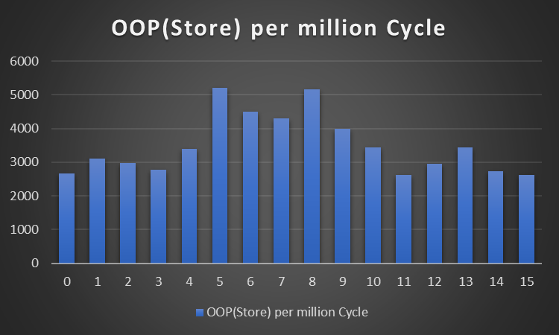
PageRank Characteristics
Total OOP load/Store access distributed uniformly among all the 16 partitions
Few cases the OOP load/store is larger than other cases, this information is useful to check for the possible corner cases in the router implementation
OOP load traffic low during the initial phase but becomes larger after 43k phase number (1 PhaseLength = 100000)
OOP Store traffic is the opposite, higher traffic during the initial phase but is reduced and more uniform around 43k phase number

Slide 26
PageRank Traffic Pattern

Slide 27
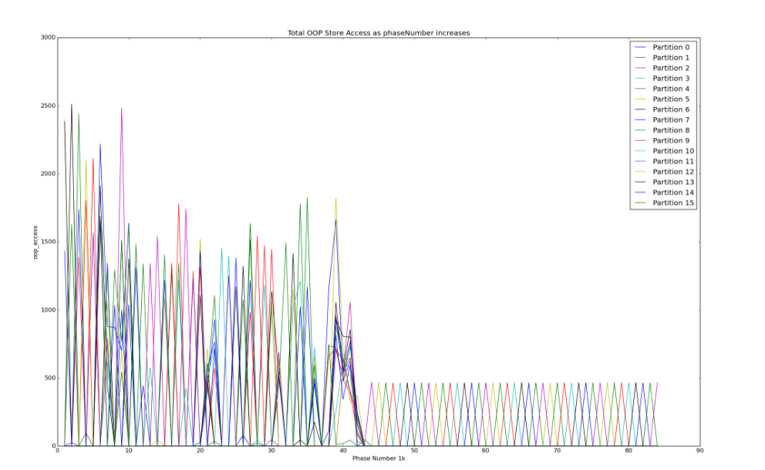
Page Rank Traffic Pattern

Slide 28
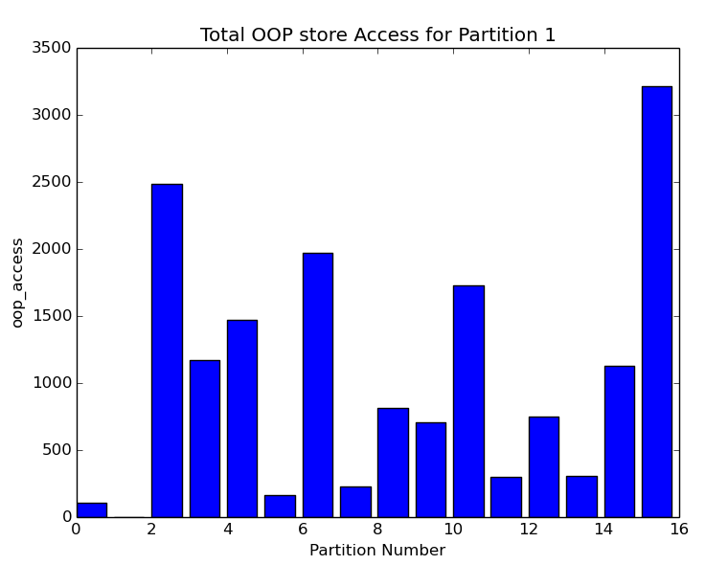
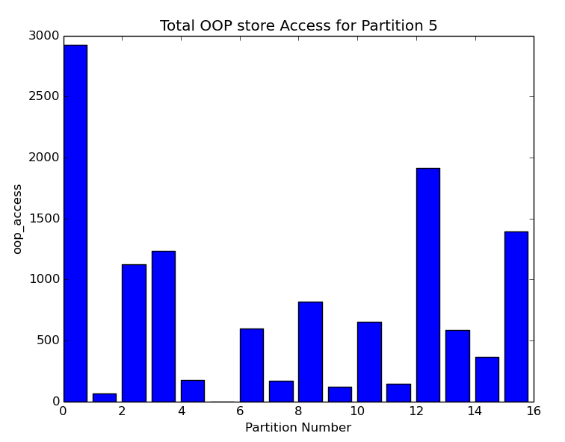
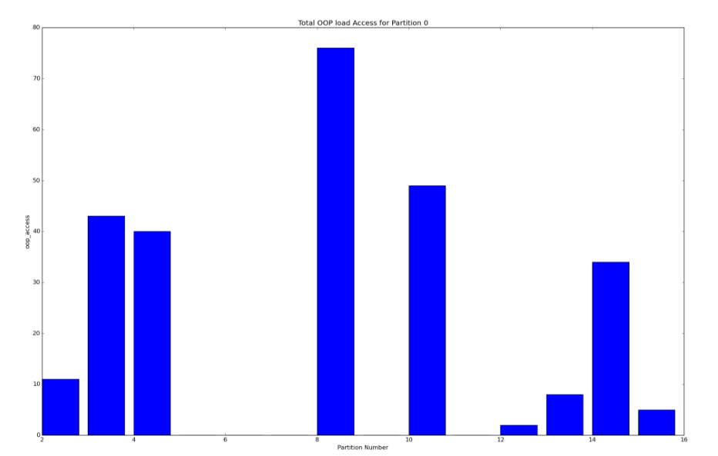
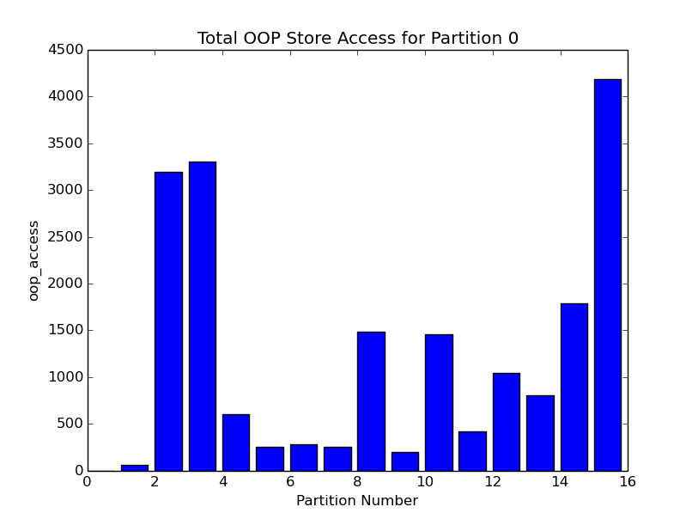
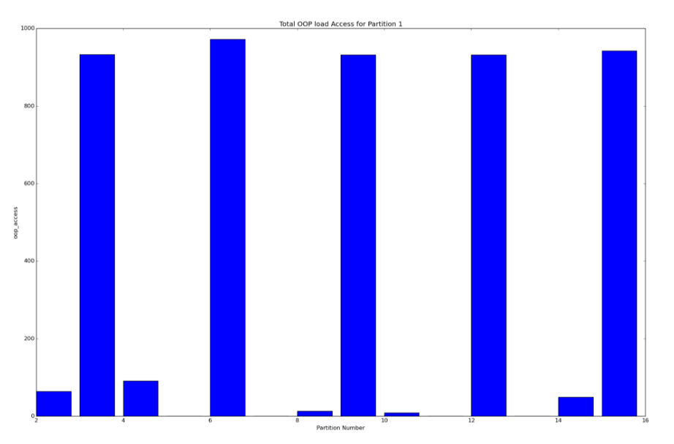
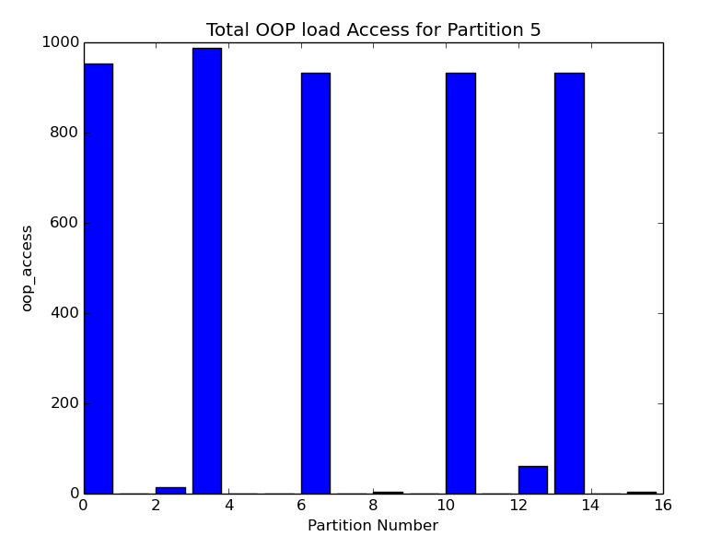
Traffic Pattern Case Study - PageRank
Difference Store Access Patterns of Different Partition
Why?
Identify possible congestion in the 4x4 mesh networks
Possible optimizations in router implementation
Our network implements uses credit based flow control, for max throughput optimal buffer size needs to be set, this is done by studying the traffic pattern
Identify better network topologies for different workloads
Difference Between Load & Store Access Patterns of same Partition
Difference Load Access Patterns of Different Partition

Slide 29
Future Work
RTL vs PInterNet Correlation for accuracy
Make PInterNet generic
Support other topologies
Integration with generic version of ZSim
Run Time improvements
Find correct region of interest and have cut off based system
Parallelize the execution of Zsim+bookism
Identify the ideal phaselength to further improve on the simulation time without compromising on the accuracy.
Pin tool crashing for more than 35000 phases(with Booksim) – debug pending
For performance evaluation, we need to try and reduce the delay further to set the workloads to be less than 10 oops/100 cycles
A more aggressive VC allocation implementation for the router
Congestion identification for Network
Apply various traffic patterns
More workload analysis

Slide 30
Conclusion
Contribution
A network congestion aware simulator for many core systems
A router design and implementation for multi core system
Learnings
Understanding a many core design
ZSim - implementation and principles of fast multi core simulators
Intricacies and tradeoffs of Network Router implementation
BookSim simulator
Shared environment development for simulators integration

Slide 31
A note of thanks
Prof. Mikko Lipasti
For guidance of network and router design and simulators
Members of Vertical Research Group
William, Vijay and Vinay
For making us understand design and help with infrastructure bring up

Slide 32
Back Up Slides

Slide 33
Page Rank Traffic Pattern
Node Degree: 2,3,4
Plot the traffic pattern of partition 0,1 and 2
0
1
2
3
4
5
6
7
8
9
10
11
12
13
14
15

Slide 34
Page Rank Traffic Pattern
Partition-0 make most of the store request to the furthest partition, partition-15
Partition-0 load pattern request is not similar to partition-0 store pattern request

Slide 35
Page Rank Traffic Pattern

Slide 36
Page Rank Traffic Pattern

Slide 37
Future Work
RTL vs PInterNet Correlation for accuracy
Run Time improvements
Find correct region of interest and have cut off based system
Parallelize the execution of Zsim+bookism
A more aggressive VC allocation implementation for the router
Identify the ideal phaselength to further improve on the simulation time without compromising on the accuracy.
Extract traffic pattern of to identify possible sources of congestion in network links
Implement PInternet for other networks like crossbar and butterfly
Using the pagerank traffic results and traffic pattern to understand the shortcoming of the current workload which will be used to identify better workloads for future work
run set of workloads with non-uniform access pattern and test network performance with different injection rate and traffic pattern

