Slide 1
Learning gem5
Jason Lowe-Power
http://www.lowepower.com/jason/learning_gem5/

Slide 2
What is gem5?
Michigan m5 + Wisconsin GEMS = gem5
“The gem5 simulator is a modular platform for computer-system architecture research, encompassing system-level architecture as well as processor microarchitecture.”
Nathan Binkert, Bradford Beckmann, Gabriel Black, Steven K. Reinhardt, Ali Saidi, Arkaprava Basu, Joel Hestness, Derek R. Hower, Tushar Krishna, Somayeh Sardashti, Rathijit Sen, Korey Sewell, Muhammad Shoaib, Nilay Vaish, Mark D. Hill, and David A. Wood. 2011. The gem5 simulator. SIGARCH Comput. Archit. News 39, 2 (August 2011), 1-7. DOI=http://dx.doi.org/10.1145/2024716.2024718

Slide 3
This tutorial
This is going to interactive
Work along with me for best results
Ask questions!!

Slide 4
Schedule
Learning Part I 8:30 – 10:00
Break 10:00 – 10:30
Learning Part II 10:30 – 12:00
Lunch 12:00 – 1:30
Code Sprint I 1:30 – 3:00
Break 3:00 – 3:30
Code Sprint II 3:30 – 5:00
Learning Part I:
Building gem5
Config scripts
gem5 output
Simple SimObject
Learning Part II:
Event-driven simulation
SimObject parameters
Memory system objects
Other gem5 features
Code Sprint I:
New gem5 contributions [Andreas Sandberg]
Begin sprints!
Code Sprint II:
Continue sprints!

Slide 5
Building gem5
http://learning.gem5.org/book/part1/building.html

Slide 6
Let’s get started!
Switch!
> git clone https://gem5.googlesource.com/public/gem5
> cd gem5
> scons build/X86/gem5.opt –j5
and now we wait (about 8 minutes)

Slide 7
> scons build/X86/gem5.opt –j5
scons: the build system that gem5 uses (like make). See http://scons.org/
build/X86/gem5.opt: “parameter” passed to scons. gem5’s Sconscript interprets this. Also, the patch to the gem5 executable.
X86: Specifies the default build options. See build_opts/*
opt: version of executable to compile (one of debug, opt, perf, fast)
Notes:
You may want to build debug if you have < 8GB of memory.

Slide 8
gem5 architecture
gem5 consists of “SimObjects”
Most C++ objects in gem5 inherit from class SimObject
Represent physical system components

Slide 9
gem5 architecture
gem5 is a discrete event simulator
Event at head dequeued
Event executed
More events queued
Event Queue
Event - 52
Event - 50
We’ll cover more after the break
Event - 50
Event - 55
Event - 20
All SimObjects can enqueue events to the event queue
Event - 11
Event - 10

Slide 10
gem5 configuration scripts
http://learning.gem5.org/book/part1/simple_config.html
http://learning.gem5.org/book/part1/cache_config.html

Slide 11
gem5 user interface
gem5 completely controlled by Python scripts
Scripts define system to model
All (C++) SimObjects exposed to Python
So… let’s make one!

Slide 12
Simple config script
Single CPU connected to a memory bus
Switch!

Slide 13
Simple config script
http://learning.gem5.org/book/_downloads/simple.py

Slide 14
Running gem5
> build/X86/gem5.opt configs/myscripts/simple.py
build/X86/gem5.opt: the gem5 binary to run
configs/…/simple.py: the configuration script (config script)

Slide 15
Port interface
| system.cpu.icache_port = system.membus.slave
| system.cpu.dcache_port = system.membus.slave
| ...
| system.mem_ctrl.port = system.membus.master
Ports connect MemObjects
To register a connection between master and slave, use ‘=’ in Python
Requests
Master
Slave
Responses

Slide 16
Syscall Emulation (SE) mode
| process = LiveProcess()
| process.cmd = [‘tests/.../hello’]
| system.cpu.workload = process
| ...
| root = Root(full_system = False)
SE mode emulates the operating system (Linux) syscalls. No OS runs.
process: an emulated process with emulated page tables, file descriptors, etc.
Full system mode runs a full OS as if gem5 is a “bare metal” system. Like full virtualization.

Slide 17
Going further: Adding caches
http://learning.gem5.org/book/part1/cache_config.html
Extending SimObjects in Python config
Object-oriented config files
Adding command-line parameters
Switch!

Slide 18
It’s just Python!
| class L1Cache(Cache):
| ...
|
| class L1ICache(L1Cache):
| def connectCPU(self, cpu):
| self.cpu_side = cpu.icache_port
| ...
Use good object-oriented design!
See text for details
Debugging config files is easy. Just add some print statements!
Use Python builtins to provide support for command line parameters.

Slide 19
Understanding gem5 output
http://learning.gem5.org/book/part1/gem5_stats.html

Slide 20
Understanding gem5 output
> ls m5out
config.ini config.json stats.txt
config.ini: Dumps all of the parameters of all SimObjects.
This shows exactly what you simulated.
stats.txt: Detailed statistic output. Each SimObject defines and updates statistics. They are printed here at the end of simulation.
config.json: Same as config.ini, but in json format.

Slide 21
stats.txt
Switch!
---------- Begin Simulation Statistics ----------
sim_seconds 0.000346 # Number of seconds simulated
sim_ticks 345518000 # Number of ticks simulated
final_tick 345518000 # Number of ticks from beginning ...
sim_freq 1000000000000 # Frequency of simulated ticks
...
sim_insts 5712 # Number of instructions simulated
sim_ops 10314 # Number of ops (including micro ...
...
system.mem_ctrl.bytes_read::cpu.inst 58264 # Number of bytes ...
system.mem_ctrl.bytes_read::cpu.data 7167 # Number of bytes ...
...
system.cpu.committedOps 10314 # Number of ops (...
system.cpu.num_int_alu_accesses 10205 # Number of integer ...
sim_seconds: name of stat. This shows simulated guest time
Every SimObject can have its own stats. Names are what you used in the Python config file

Slide 22
A simple SimObject
http://learning.gem5.org/book/part2/helloobject.html

Slide 23
gem5’s coding guidelines
Follow the style guide (http://www.gem5.org/Coding_Style)
Install the style guide when scons asks
Don’t ignore style errors
Use good development practices
<Add something here about git branches?>

Slide 24
Adding a new SimObject
Step 1: Create a Python class
Step 2: Implement the C++
Step 3: Register the SimObject and C++ file
Step 4: (Re-)build gem5
Step 5: Create a config script
Switch!

Slide 25
Step 1: Create a Python class
HelloObject.py
m5.params: Things like MemorySize, Int, etc.
| from m5.params import *
| from m5.SimObject import SimObject
|
| class HelloObject(SimObject):
| type = ‘HelloObject’
| cxx_header = ‘learning_gem5/hello_object.hh’
Import the objects we need
type: The C++ class name
cxx_header: The filename for the C++ header file

Slide 26
Step 2: Implement the C++
hello_object.hh
params/*.hh generated automatically. Comes from Python SimObject definition
| #include "params/HelloObject.hh"
| #include "sim/sim_object.hh"
| class HelloObject : public SimObject
| {
| public:
| HelloObject(HelloObjectParams *p);
| };
Constructor has one parameter, the generated params object.

Slide 27
Step 2: Implement the C++
HelloObjectParams: when you specify a Param in the Hello.py file, it will be a member of this object.
hello_object.cc
HelloObject::HelloObject(HelloObjectParams *params) : SimObject(params)
{
std::cout << "Hello World! From a SimObject!" << std::endl;
}
HelloObject*
HelloObjectParams::create()
{
return new HelloObject(this);
}
You must define this function (you’ll get a linker error otherewise). This is how Python config creates the C++ object.

Slide 28
Step 3: Register the SimObject and C++ file
SConscript
Import: SConscript is just Python… but weird.
| Import(*)
| SimObject(‘Hello.py’)
| Source(‘hello_object.cc’)
SimObject(): Says that this Python file contains a SimObject. Note: you can put pretty much any Python in here
Source(): Tell scons to compile this file (e.g., with g++).

Slide 29
Step 4: (Re-)build gem5

Slide 30
Step 5: Create a config script
Instantiate the new object that you created in the config file (e.g., simple.py)
| ...
| system.hello = HelloObject()
| ...
> build/X86/gem5.opt configs/learning_gem5/hello.py
...
Hello world! From a SimObject!
...

Slide 31
Simple SimObject code
http://learning.gem5.org/book/_downloads/HelloObject.py
http://learning.gem5.org/book/_downloads/hello_object.hh
http://learning.gem5.org/book/_downloads/hello_object.cc
http://learning.gem5.org/book/_downloads/SConscript
http://learning.gem5.org/book/_downloads/run_hello.py

Slide 32
Debug support in gem5
http://learning.gem5.org/book/part2/debugging.html

Slide 33
Adding debug flags
SConscript
Switch!
Declare the flag: add the debug flag to the SConscript file in the current directory
DebugFlag(‘Hello’)
hello_object.cc
DPRINTF(Hello, “Created the hello object”);
Hello: the debug flag declared in the SConscript.
Found in “debug/hello.hh”
Debug string: Any C format string
DPRINTF: macro for debug statements in gem5

Slide 34
Debugging gem5
Switch!
> build/X86/gem5.opt --debug-flags=Hello configs/learning_gem5/hello.py
...
0: system.hello: Hello world! From a debug statement
debug-flags: Comma separated list of flags to enable. Other options include --debug-start=<tick>, --debug-ignore=<simobj name>,
etc. See gem5.opt --help

Slide 35
Event-driven programming
http://learning.gem5.org/book/part2/events.html

Slide 36
Simple event callback
Switch!
EventWrapper: Convenience class for simple events with no parameters.
| class HelloObject : public SimObject
| {
| private:
| ...
| void processEvent();
| EventWrapper<HelloObject,
| &HelloObject::processEvent> event;
| public:
| HelloObject(HelloObjectParams *p);
| void startup();
| };
processEvent: Callback function to run when event fires.
startup: Called after all SimObjects instantiated. Schedule local events here.

Slide 37
Simple event callback
Switch!
schedule: Put an event instance on the event queue. An absolute tick used for when the event is processed.
| void
| HelloObject::processEvent()
| {
| timesLeft--;
| DPRINTF(Hello, "Hello world!"
| " Processing the event! %d left\n", timesLeft);
| if (timesLeft <= 0) {
| DPRINTF(Hello, "Done firing!\n");
| } else {
| schedule(event, curTick() + latency);
| }
| }
curTick: Returns the current simulator time. Useful for relative time computations.

Slide 38
Event SimObject code
http://learning.gem5.org/book/_downloads/hello_object1.hh
http://learning.gem5.org/book/_downloads/hello_object2.cc

Slide 39
SimObject parameters
http://learning.gem5.org/book/part2/parameters.html

Slide 40
Adding parameters
Switch!
| class HelloObject(SimObject):
| type = 'HelloObject'
| cxx_header = "learning_gem5/hello_object.hh"
|
| time_to_wait = Param.Latency("Time before firing the event")
| number_of_fires = Param.Int(1, "Number of times to fire the event before "
| "goodbye")
Param.<TYPE>: Specifies a parameter of type <TYPE> for the SimObject
Param.<TYPE>(): First parameter: default value. Second parameter:

Slide 41
Going further: More parameters
http://learning.gem5.org/book/part2/parameters.html
Included types (e.g., MemorySize, MemoryBandwidth, Latency)
Using a SimObject as a parameter
SimObject-SimObject interaction

Slide 42
MemObjects
http://learning.gem5.org/book/part2/memoryobject.html

Slide 43
MemObject
Object that is part of gem5’s memory system
both classic caches and Ruby are MemObjects
Allowed to have MasterPorts and SlavePorts

Slide 44
Packets
Unit of transfer between MemObjects
Packets pass between Master and Slave ports
Packets have
Request
Command
Data
Much more…

Slide 45
Master and slave ports
sendTimingReq: send a Packet containing a request from a master to a slave
Master
Slave
sendTimingReq
recvTimingReq
returns: true
Slave executes request
return true: The slave can handle the request.
Time
recvTimingReq: function that is called to handle the request in the slave port.

Slide 46
Master and slave ports
Master
Slave
sendTimingResp: The slave finishes processing the request, and now sends a response (same packet).
sendTimingReq
recvTimingReq
returns: true
Slave executes request
Time
recvTimingResp
sendTimingResp
recvTimingResp: Handles the response from the slave. Returning true means the packet is handled.
returns: true

Slide 47
Master and slave ports
return false: Slave cannot currently process the Packet. Resend the packet later. The Master’s responsibility to track Packet.
Master
Slave
sendTimingReq
recvTimingReq
returns: false
Slave busy
recvReqRetry: Can now retry the request by calling sendTimingReq.
Time
recvReqRetry
sendReqRetry
sendTimingReq
recvTimingReq
returns: true
sendReqRetry: Tell the master it can retry the stalled Packet.

Slide 48
Master and slave ports
return false: Master cannot currently process the Packet. Resend the packet later. The Slave’s responsibility to track Packet.
Master
Slave
recvTimingResp
sendTimingResp
returns: false
sendRespRetry: Slave can now retry the response.
Master busy
sendRespRetry
recvRespRetry
recvTimingResp
sendTimingResp
returns: true

Slide 49
Master and slave port interface
Master
Slave
recv​‌ Timing Resp
recv Req Retry
recv Range Change
recv Timing Req
recv Resp Retry
recv Functional
get Addr Ranges

Slide 50
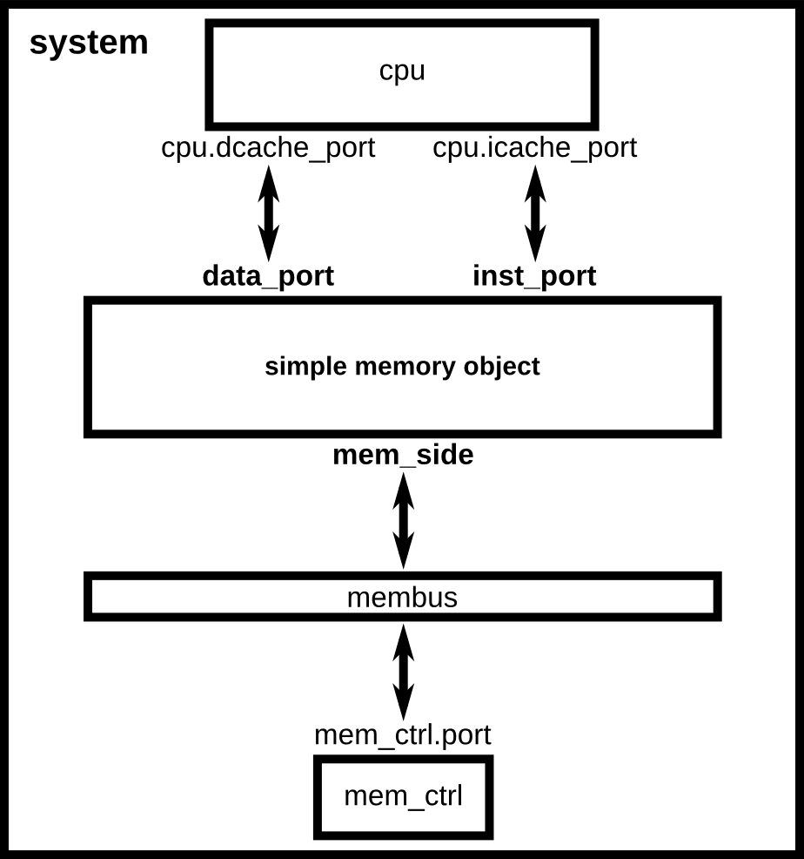
Simple MemObject
Switch!

Slide 51
Going further: Implementing a cache
http://learning.gem5.org/book/part2/simplecache.html
Full implementation of a uniprocessor cache (no coherence support)
Emulation concepts (using STL for associative data)
Vector ports, clocked objects, upgrading and creating packets

Slide 52
Other gem5 concepts
A random assortment

Slide 53
ISA support
gem5 supports many ISA
ARM: ARM Research often contributes
x86: Very complicated, there are a few bugs
RISC-V: Recent contribution. SE mode working. Thanks Alec!
Alpha, MIPS, SPARC, Power: No maintainers. Not very supported.

Slide 54
CPU Models
gem5 exposes a flexible CPU interface
AtomicSimpleCPU: No timing. Fast-forwarding & cache warming.
TimingSimpleCPU: Single-cycle (IPC=1) except for memory ops.
O3CPU: Out-of-order model. Highly configurable.
MinorCPU: In-order model (not fully tested with x86)

Slide 55
Full system support
Full system is like a virtual machine.
gem5 exposes a “bare metal” interface
Requires a kernel, disk image, etc.
See http://learning.gem5.org/book/part3/ for simple x86 example

Slide 56
Coherence modeling (Ruby)
“Classic cache” vs. Ruby
Classic: MOESI only, Ruby: any protocol
Classic: Hierarchical-snooping, Ruby: Snooping or directory or…
Classic: Flexible hierarchy, Ruby: Hierarchy baked into protocol
Classic: Good baseline CMP, Ruby: Required for coherence study
Ruby protocols in src/mem/protocols
SLICC is a DSL for coherence
Not much documentation, but many examples!
Very flexible network simulation (Garnet)

Slide 57
GPU and device models
AMD recently released a HSAIL GPU model (src/gpu-compute)
Many devices supported for FS simulation
Ethernet (and multi-system simulation)
VNC for graphics
IDE controllers for disks
Most devices are functional-only

Slide 58
Other features
Probes and tracing
Remote GDB
Dynamically-linked binaries in SE mode
Power modeling
And many, many, many others

Slide 59
Caveats
gem5 is a tool, not a panacea
Most models are not validated against “real” hardware
See “Architectural Simulators Considered Harmful” https://doi.org/10.1109/MM.2015.74
There are bugs!

Slide 60
Getting (more) help
Main gem5 wiki: http://gem5.org/
My book:
Learning.gem5.org
https://github.com/powerjg/learning_gem5
Mailing lists: http://gem5.org/Mailing_Lists
gem5-users: General user questions (you probably want this one)
gem5-dev: Mostly code reviews and high-level dev talk
gem5 QA (like StackOverflow): http://qa.gem5.org/

Slide 61
Backup slides
Mostly from other versions of this tutorial

Slide 62
Adding caches
The previous example was boring
Let’s add some caches!
Switch!

Slide 63
| from m5.params import *
|...
|
| class BaseCache(MemObject):
| type = ‘BaseCache’
| abstract = True
| cxx_header = ‘mem/cache/base.hh’
|
| size = Param.MemorySize(“Capacity”)
| assoc = Param.Unsigned(“Associativity”)
| ...
| tags = Param.BaseTags(LRU(), “Tag ...”)
| ...
| cpu_side = SlavePort(“Upstream port...”)
| mem_side = MasterPort(“Downstream...”)
| ...
| class Cache(BaseCache):
| type = ‘Cache’
| cxx_header = ‘mem/cache/cache.hh’
| ...
Definition of a SimObject
The C++ class for the SimObject. And it’s header file.
size: A parameter to the SimObject, of type MemorySize.
No default, so it is required in Python config file
tags: A parameter of type BaseTags (another SimObject).
There is a default, so it is not required in Python config file

Slide 64
| from m5.params import *
|...
|
| class BaseCache(MemObject):
| type = ‘BaseCache’
| abstract = True
| cxx_header = ‘mem/cache/base.hh’
|
| size = Param.MemorySize(“Capacity”)
| assoc = Param.Unsigned(“Associativity”)
| ...
| tags = Param.BaseTags(LRU(), “Tag ...”)
| ...
| cpu_side = SlavePort(“Upstream port...”)
| mem_side = MasterPort(“Downstream...”)
| ...
| class Cache(BaseCache):
| type = ‘Cache’
| cxx_header = ‘mem/cache/cache.hh’
| ...
Ports that connect the cache to the memory system. Again, masters send requests, slaves receive requests,.
These cannot have defaults. Must specify the sender/receiver in Python config files.
Switch!

Slide 65
Cache scripts
http://learning.gem5.org/book/_downloads/caches.py
http://learning.gem5.org/book/_downloads/two_level.py

Slide 66
Architectural exploration
| ...
| system.cpu = TimingSimpleCPU()
| ...
|
DerivO3CPU: gem5’s out-of-order model
| ...
| # system.cpu = TimingSimpleCPU()
| system.cpu = DerivO3CPU()
|
| ...
| # system.cpu = TimingSimpleCPU()
| # system.cpu = DerivO3CPU()
| system.cpu = MinorCPU()
MinorCPU: gem5’s in-order model
> build/X86/gem5.opt configs/learning_gem5/part1/two_level.py
...
Exiting @ tick 56435000 because target called exit()
SimpleTiming | 56435000
DerivO3 | 30896000
4 kB L1 | 30943000
> build/X86/gem5.opt configs/learning_gem5/part1/two_level.py
...
Exiting @ tick 30896000 because target called exit()
> build/X86/gem5.opt configs/learning_gem5/part1/two_level.py
--l1d_size=4kB
Exiting @ tick 30943000 because target called exit()

Slide 67
Next time…
How to make changes to gem5
Adding new SimObjects
What’s in gem5
Let me know (powerjg@cs.wisc.edu) anything specific to cover!

Slide 68
Switch!
scons: the build system that gem5 uses (like make). See http://scons.org/
> hg clone http://repo.gem5.org
> cd gem5
> scons build/X86/gem5.opt –j5

